Slide 1
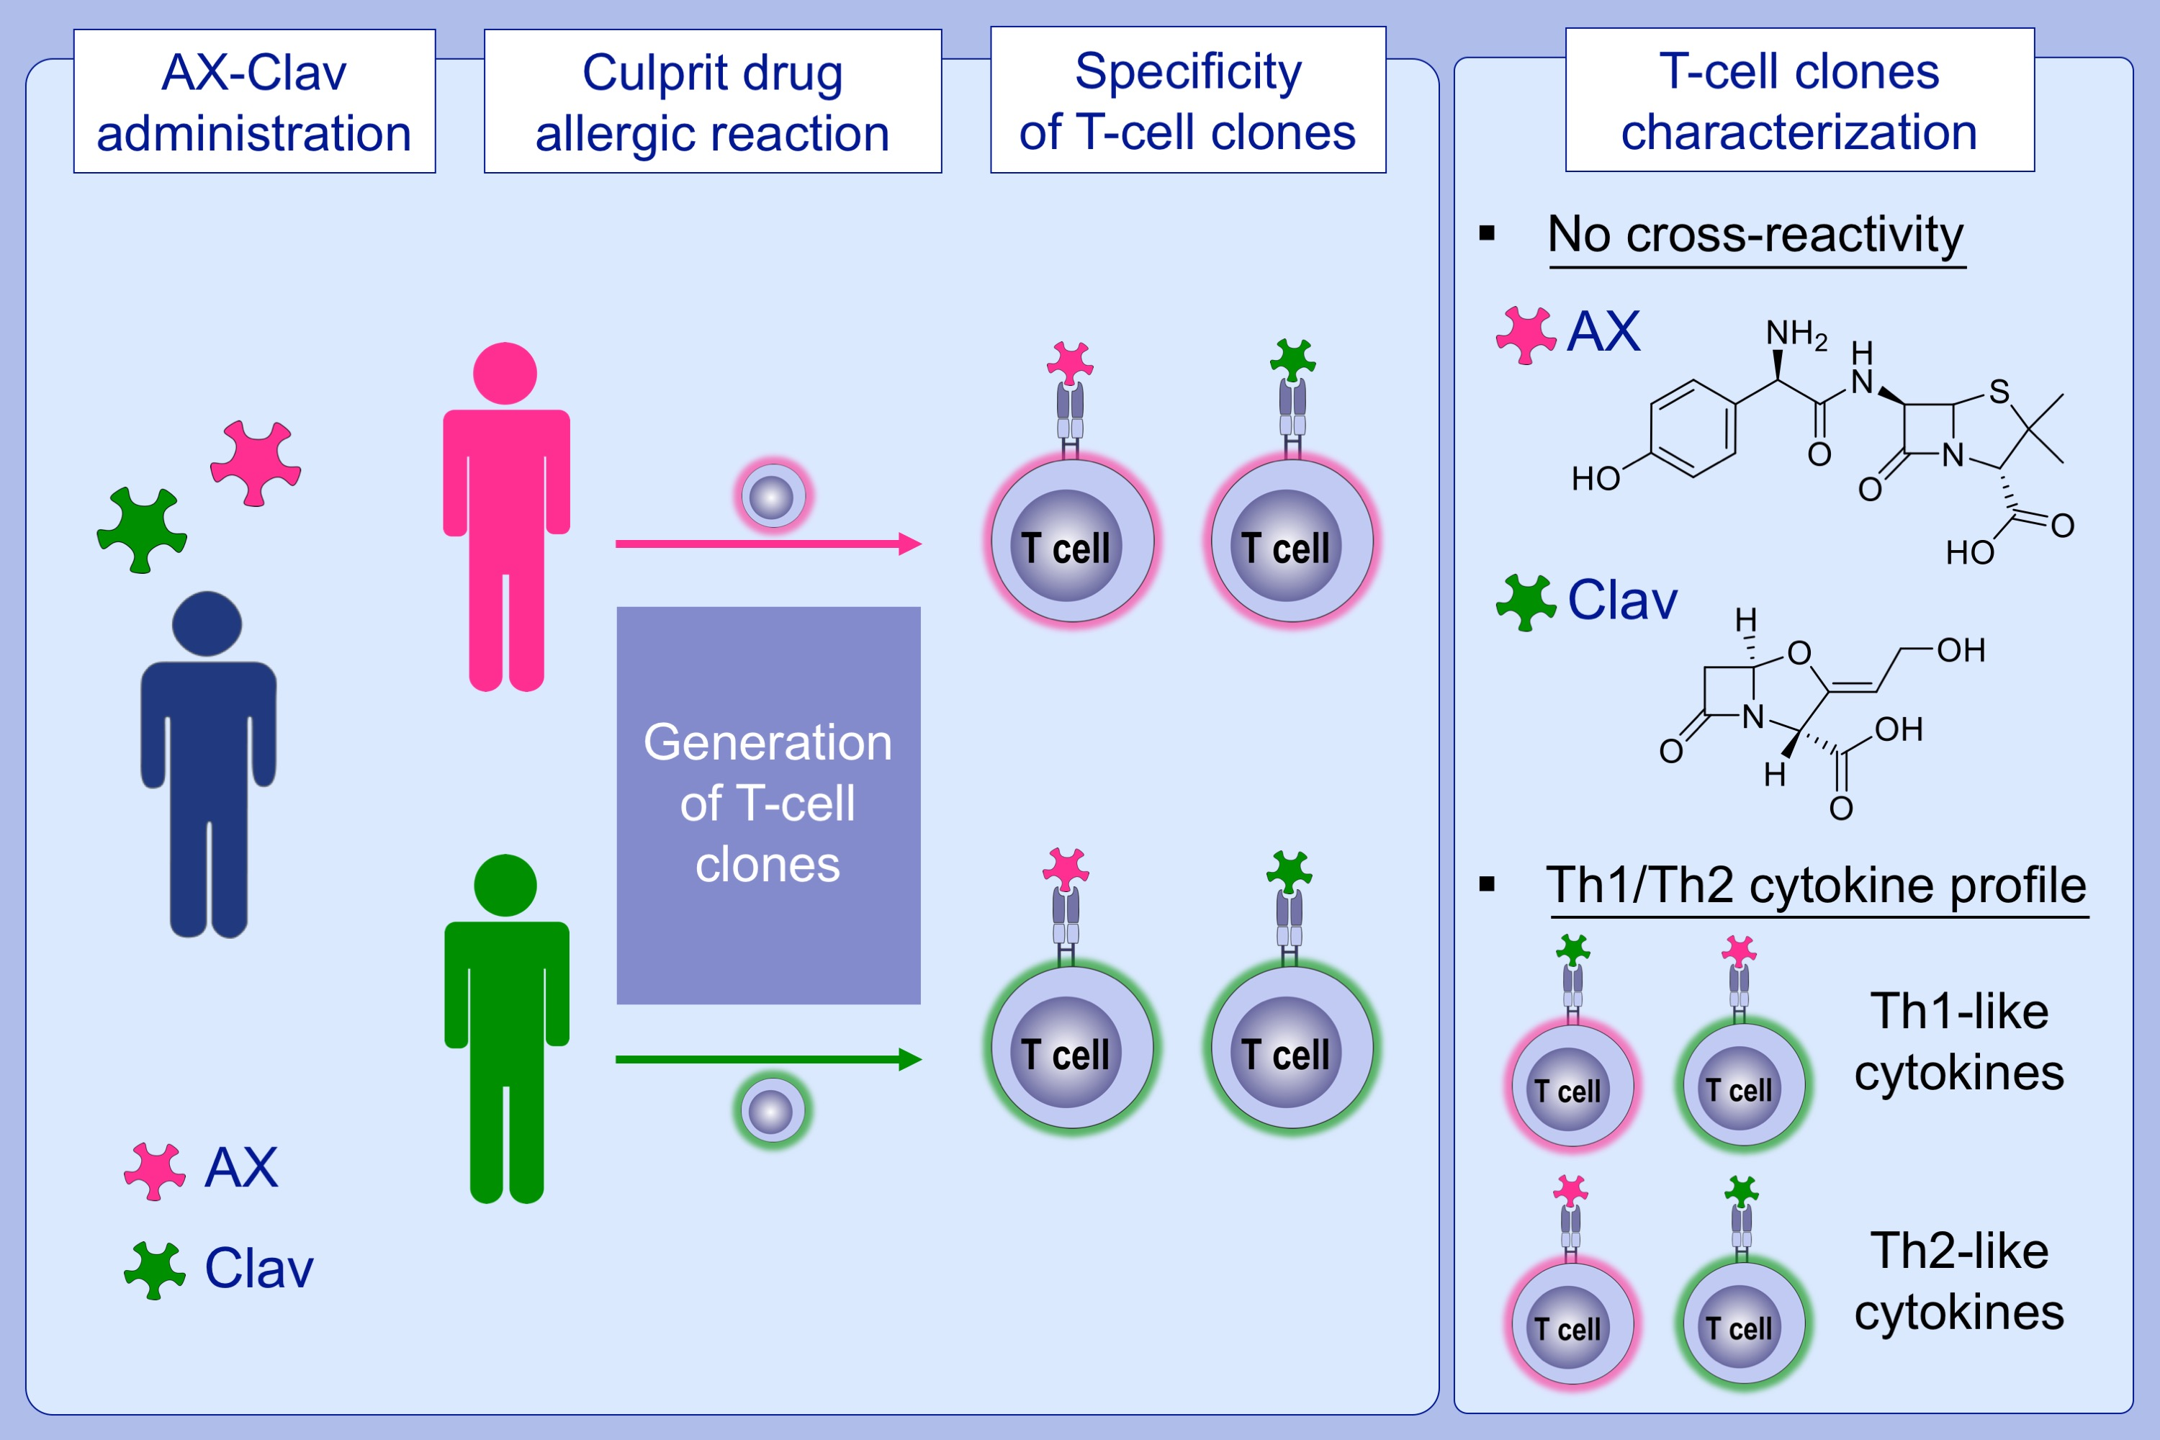
Characterization of amoxicillin and clavulanic acid specific T‐cell clones from patients with immediate drug hypersensitivity
Adriana Ariza, Rubén Fernández‐Santamaría, Xiaoli Meng, María Salas, Monday O. Ogese, et al.
Allergy. 2020; 2562-2573 https://doi.org/10.1111/all.14298
© 2019 EAACI and John Wiley and Sons A/S. Published by John Wiley and Sons Ltd.
Notes:
HIGHLIGHTS
• AX- and Clav-specific T-cell clones can be generated from the same patient with immediate hypersensitivity, irrespective of whether AX or Clav is the culprit drug in the combination AX-Clav.
• No cross-reactivity between AX and Clav is detected.
Abbreviations: AX, amoxicillin; Clav, clavulanic acid

