Slide 1
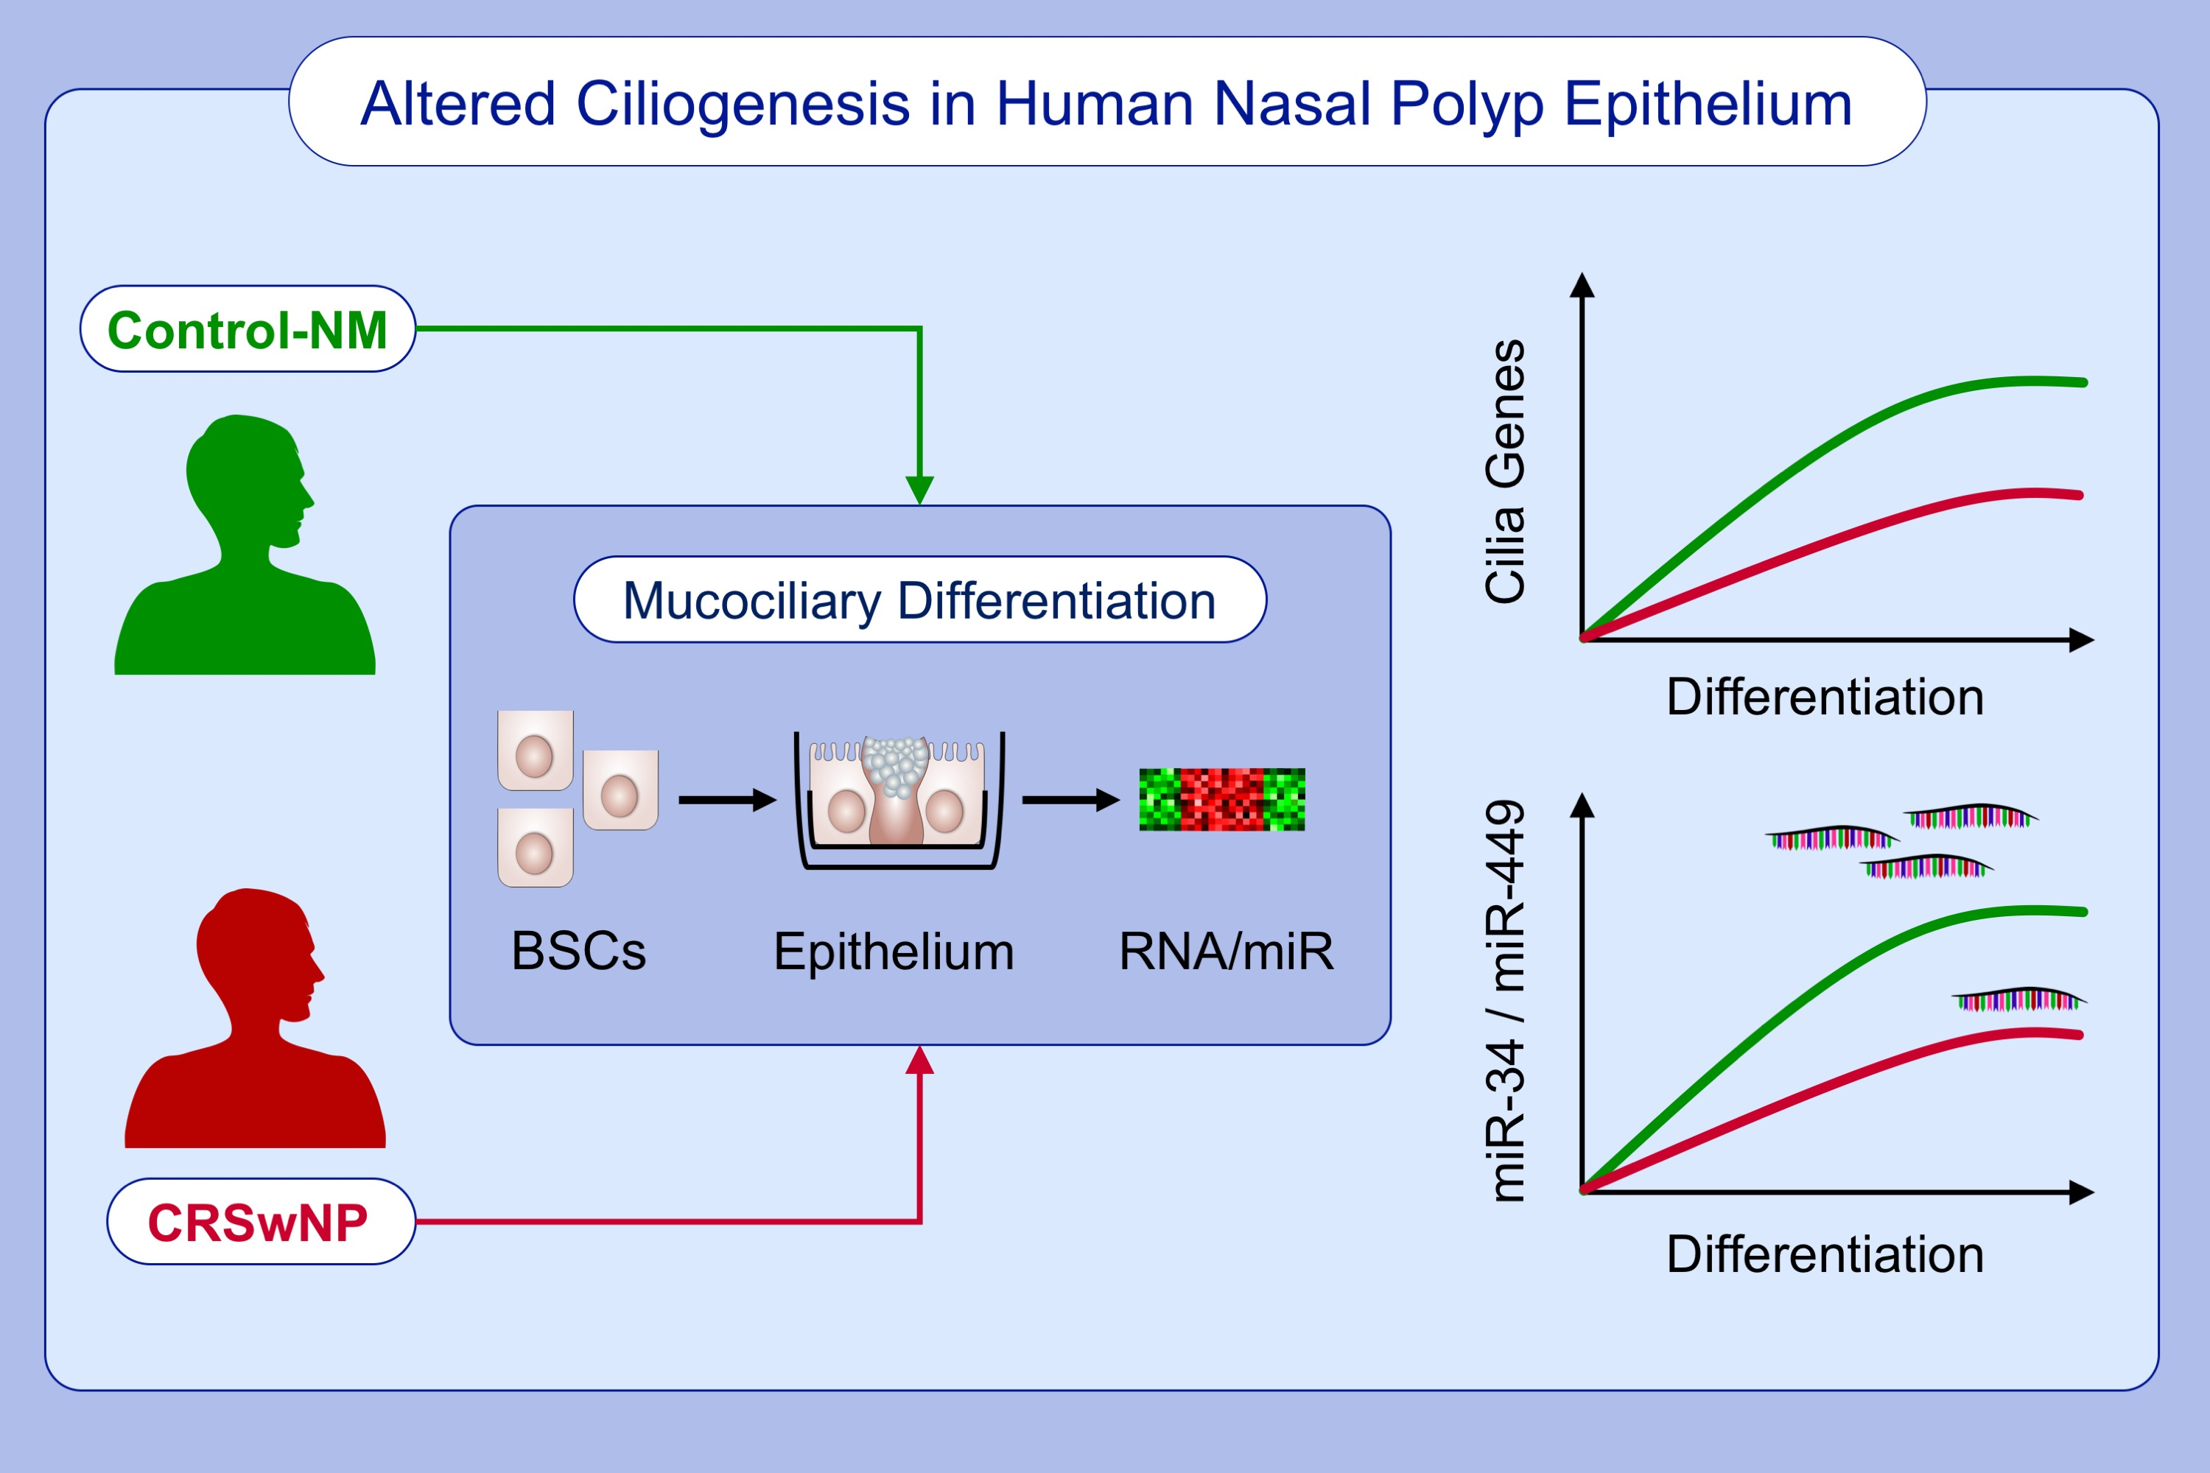
Integrated mRNA and microRNA transcriptome profiling during differentiation of human nasal polyp epithelium reveals an altered ciliogenesis
Borja Callejas‐Díaz, Guerau Fernandez, Mireya Fuentes, Asunción Martínez‐Antón, Isam Alobid, et al.
Allergy. 2020; 2548-2561 https://doi.org/10.1111/all.14307
© 2019 EAACI and John Wiley and Sons A/S. Published by John Wiley and Sons Ltd.
Notes:
HIGHLIGHTS
• This study provides an insight into the molecular basis of sinonasal mucociliary differentiation.
• mRNA and microRNA transcriptome profiling reveal an altered ciliogenesis in CRSwNP compared to control-NM.
Abbreviations: BSCs, basal stem-progenitor cells; control-NM, control nasal mucosa; CRSwNP, chronic rhinosinusitis with nasal polyps; ALI, air-liquid interface cell culture system; miR, microRNA

