Slide 1
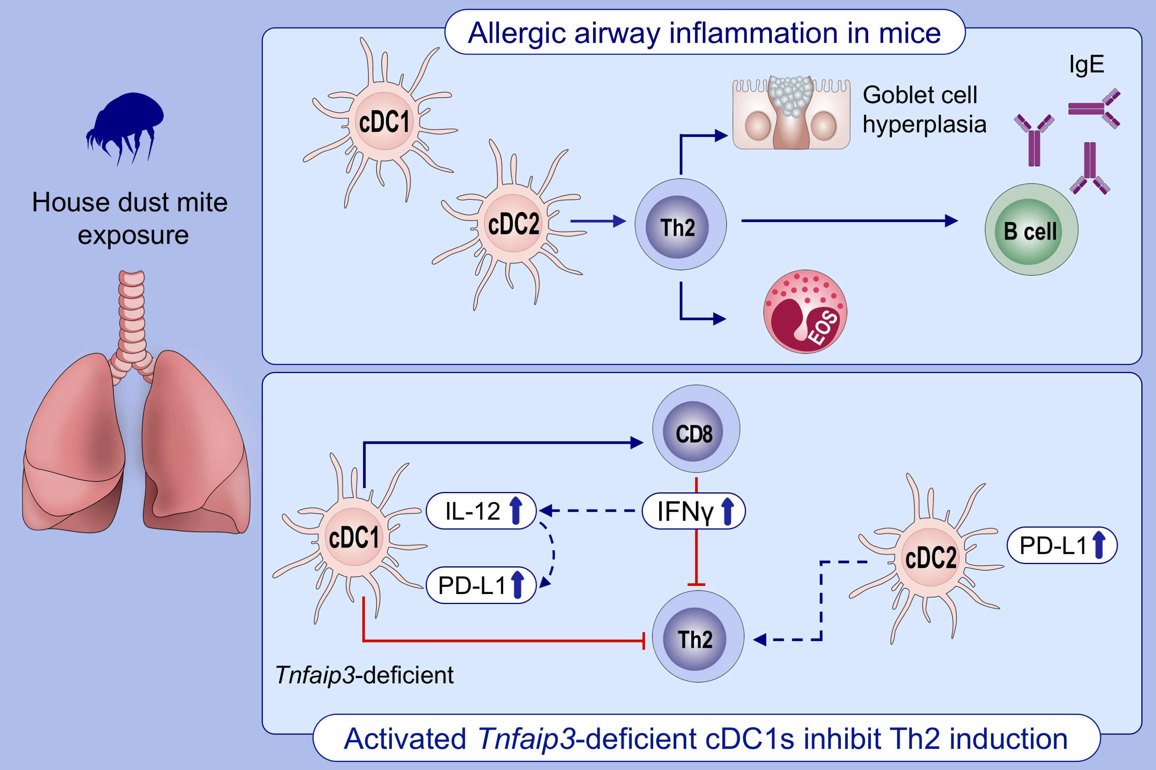
Tnfaip3 expression in pulmonary conventional type 1 Langerin‐expressing dendritic cells regulates T helper 2‐mediated airway inflammation in mice
Heleen Vroman, Denise van Uden, Ingrid M. Bergen, Jennifer A. C. van Hulst, Melanie Lukkes, et al.
Allergy. 2020; 2587-2598 https://doi.org/10.1111/all.14334
© 2019 EAACI and John Wiley and Sons A/S. Published by John Wiley and Sons Ltd.
Notes:
HIGHLIGHTS
• Mice harboring Tnfaip3-deficient cDC1s (Tnfaip3Lg-KO mice) do not develop Th2-driven eosinophilic airway inflammation upon house dust mite exposure but have elevated numbers of pulmonary IFNγ-expressing CD8+ T-cells.
• In the lungs of Tnfaip3Lg-KO mice, cDC1s have increased IL-12 and PD-L1 expression.
Abbreviations: cDC, conventional dendritic cell; PD-L1, programmed death ligand 1; Tnfaip3, TNF alpha-induced protein 3

