Slide 1
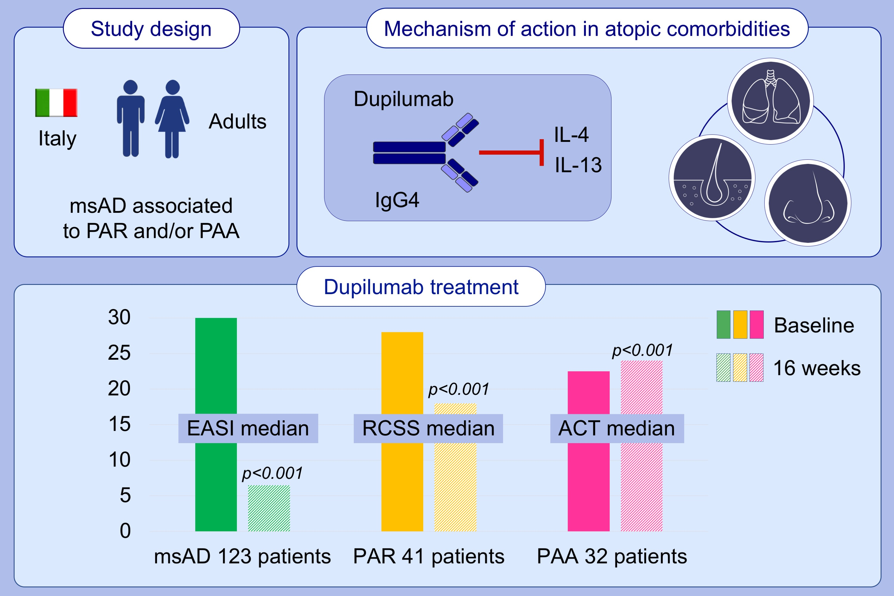
Efficacy of dupilumab in atopic comorbidities associated with moderate‐to‐severe adult atopic dermatitis
Eustachio Nettis, Vincenzo Patella, Carla Lombardo, Aikaterini Detoraki, Luigi Macchia, et al.
Allergy. 2020; 2653-2661 https://doi.org/10.1111/all.14338
© 2019 EAACI and John Wiley and Sons A/S. Published by John Wiley and Sons Ltd.
Notes:
HIGHLIGHTS
• This study explores the potential benefit of dupilumab in PAR and PAA caused by indoor allergens in adults with msAD.
• These results support the benefits of dupilumab for adult patients with PAR and/or PAA associated with msAD.
• In addition, dupilumab treatment significantly improves disease severity and QoL in patients with msAD.
Abbreviations: ACT, asthma control test; EASI, eczema area severity index; msAD, moderate-to-severe atopic dermatitis; PAA, perennial allergic asthma; PAR, perennial allergic rhinoconjunctivitis; QoL, quality of life; RCSS, rhinitis control scoring system
.

