Slide 1
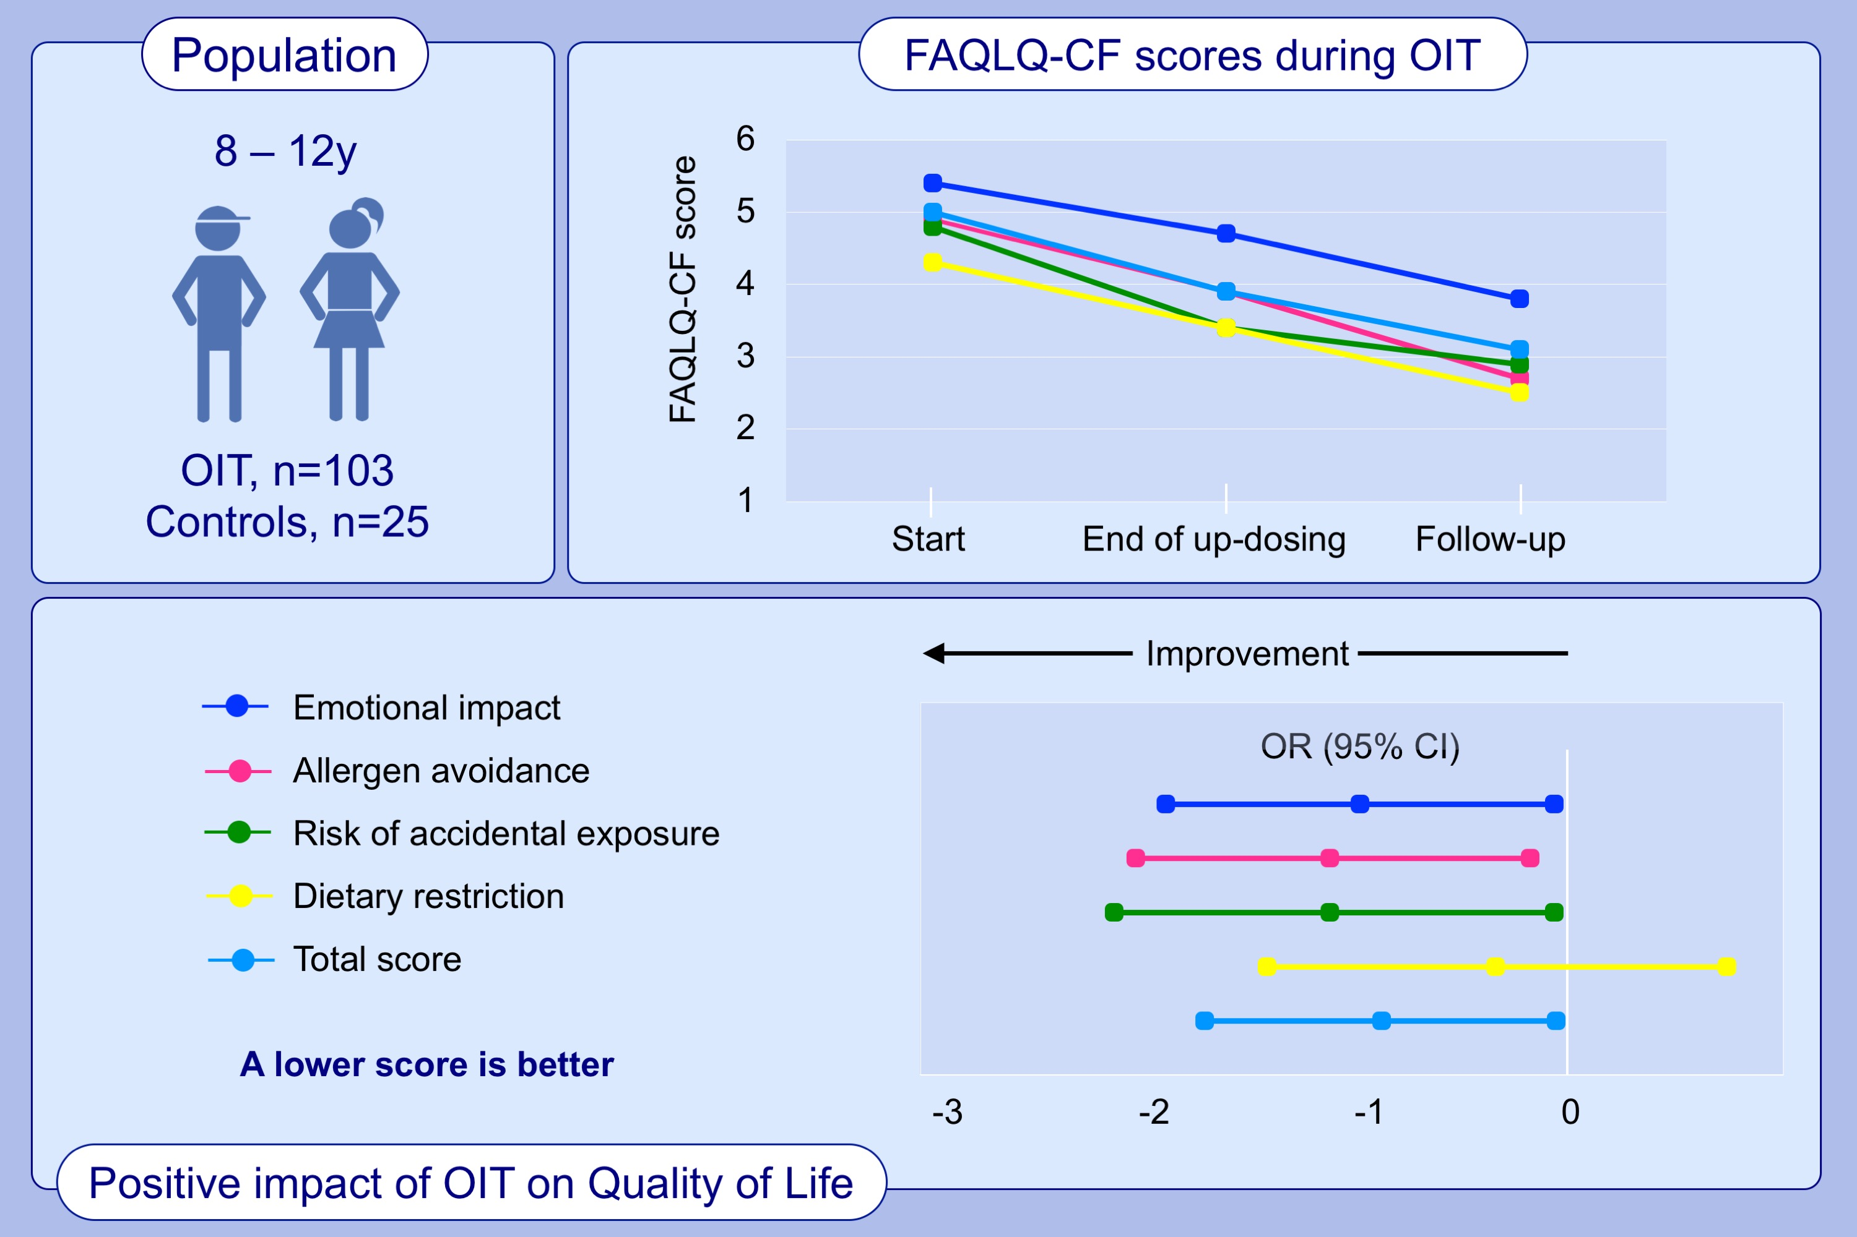
Quality of life of children aged 8‐12 years undergoing food allergy oral immunotherapy: Child and parent perspective
Na'ama Epstein‐Rigbi, Michael R. Goldberg, Michael B. Levy, Liat Nachshon, Arnon Elizur, et al.
Allergy. 2020; 2623-2632 https://doi.org/10.1111/all.14350
© 2019 EAACI and John Wiley and Sons A/S. Published by John Wiley and Sons Ltd.
Notes:
HIGHLIGHTS
• FAQLQ-CF was administered to 103 children aged 8-12 years undergoing OI for food allergy and to 25 food-allergic controls.
• Children undergoing OIT experienced a significant improvement in quality of life at maintenance and an additional improvement at 6-months follow-up, a time-point representing the real-world impact of the treatment on their lives.
Abbreviations: FAQLQ-CF, Food Allergy Quality of Life Questionnaire-Child Form; OD, Odds Ratio; OIT, Oral Immunotherapy

