Slide 1
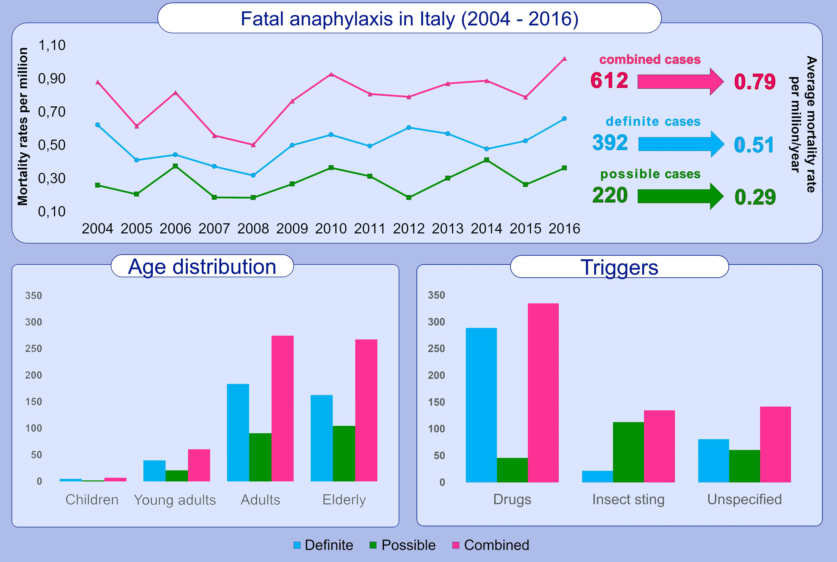
Fatal anaphylaxis in Italy: Analysis of cause‐of‐death national data, 2004‐2016
Maria Beatrice Bilò, Alice Corsi, Matteo Martini, Elena Penza, Francesco Grippo, et al.
Allergy. 2020; 2644-2652 https://doi.org/10.1111/all.14352
© 2019 EAACI and John Wiley and Sons A/S. Published by John Wiley and Sons Ltd.
Notes:
HIGHLIGHTS
• Data reported to the National Register of Causes of Death database (2004-2016) were analyzed identifying the ICD-10 codes related to anaphylaxis, divided in “Definite” and “Possible”.
• The average mortality rate was 0.51 million population/year for definite anaphylaxis, 0.29 for possible, and 0.79 for combined cases.

