Slide 1
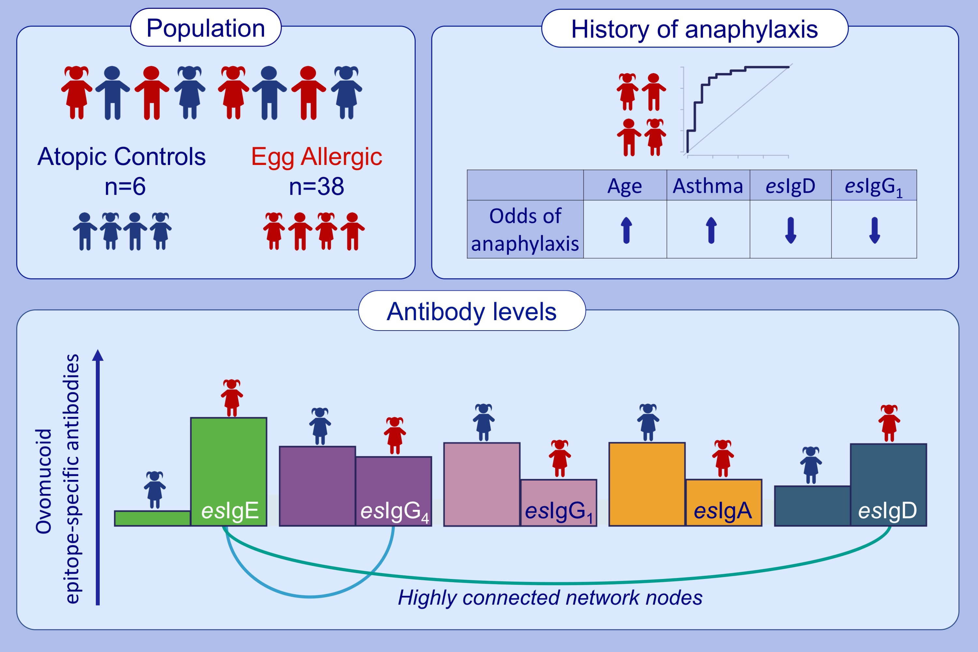
Ovomucoid epitope‐specific repertoire of IgE, IgG4, IgG1, IgA1, and IgD antibodies in egg‐allergic children
Maria Suprun, Robert Getts, Galina Grishina, Angela Tsuang, Mayte Suárez‐Fariñas, et al.
Allergy. 2020; 2633-2643 https://doi.org/10.1111/all.14357
© 2019 EAACI and John Wiley and Sons A/S. Published by John Wiley and Sons Ltd.
Notes:
HIGHLIGHTS
• Egg allergic children have lower levels of epitope-specific (es)IgA1 and esIgG1 but higher esIgE and esIgD compared to the atopic controls.
• Within the allergic group, children with higher esIgD antibodies have decreased odds of anaphylactic reactions.

