Slide 1
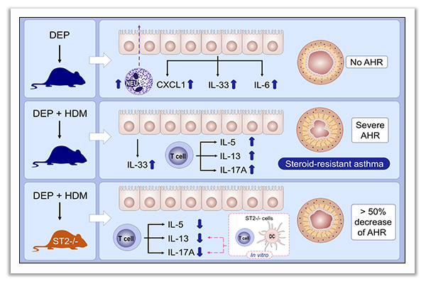
IL33 contributes to diesel pollution‐mediated increase in experimental asthma severity
Eric B. Brandt, Paige E. Bolcas, Brandy P. Ruff, Gurjit K. Khurana Hershey
Allergy. 2020; 2254-2266 https://doi.org/10.1111/all.14181
© 2019 EAACI and John Wiley and Sons A/S. Published by John Wiley and Sons Ltd.
Notes:
HIGHLIGHTS
• DEP induce IL-33 but not allergic disease, whereas HDM and DEP co-exposure promote a mixed Th2/Th17 response and elevated AHR.
• IL-33 receptor deficient (ST2-/-) mice had milder allergic airway disease with decreased IL-13, and fewer T-cells and pathogenic IL5+IL17A+ co-producing T-cells.

