Slide 1
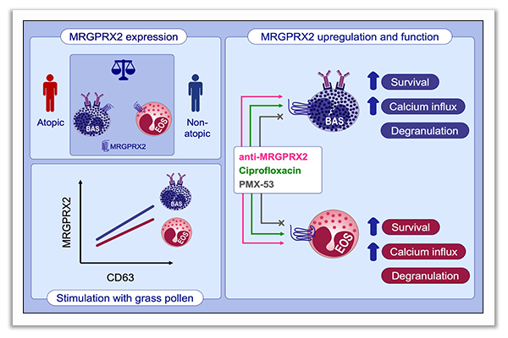
The pseudoallergen receptor MRGPRX2 on peripheral blood basophils and eosinophils: Expression and function
Bettina Wedi, Manuela Gehring, Alexander Kapp
Allergy. 2020; 2229-2242 https://doi.org/10.1111/all.14213
© 2019 EAACI and John Wiley and Sons A/S. Published by John Wiley and Sons Ltd.
Notes:
HIGHLIGHTS
MRGPRX2 is not mast-cell-specific, as it is expressed on comparable levels on peripheral blood basophils and eosinophils, but not neutrophils, from atopic and non-atopic donors.
Engagement of MRGPRX2 by monoclonal antibodies results in calcium influx, enhanced survival, and degranulation with release of cytokines. Mast-cell MRGPRX2 ligand ciprofloxacin, but not PMX-53, shows similar effects#
Granulocyte activation test with grass pollen in allergic subjects results in basophil and eosinophil MRGPRX2 upregulation similar to CD63 upregulation.
Abbreviations: MRGPRX2, mas-related G-protein coupled receptor X2; PMX-53, C5a receptor antagonist; #, survival not assessed with ciprofloxacin, cytokine release not assessed with PMX-53

