Slide 1
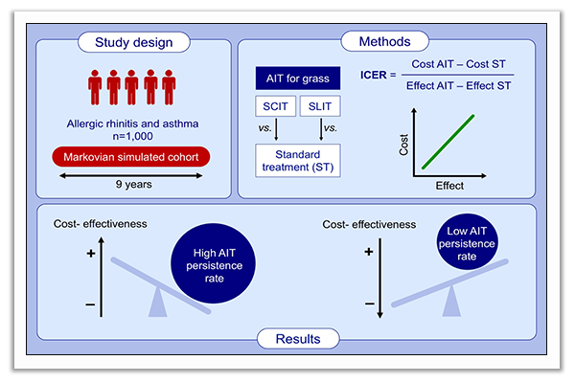
Cost‐effectiveness of grass pollen allergen immunotherapy in adults
Danilo Di Bona, Massimo Bilancia, Marcello Albanesi, Maria Filomena Caiaffa, Luigi Macchia, et al.
Allergy. 2020; 2319-2329 https://doi.org/10.1111/all.14246
© 2019 EAACI and John Wiley and Sons A/S. Published by John Wiley and Sons Ltd.
Notes:
HIGHLIGHTS
Both SCIT and SLIT for grass pollen are more effective, but also more expensive than standard pharmacological treatment.
AIT treatment persistence (i.e. completion of the minimal recommended duration of 3 years) significantly affects cost-effectiveness.
In daily practice AIT for grass pollens may be a cost-effective option only in patients with high treatment persistence rates.
Abbreviations: AIT, allergen immunotherapy; SCIT, subcutaneous immunotherapy; SLIT, sublingual immunotherapy; ICER, incremental cost-effectiveness ratio

