Slide 1
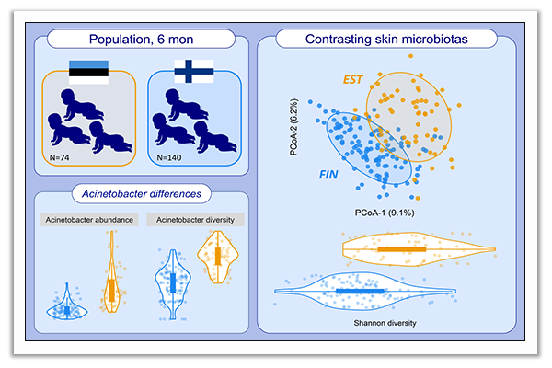
Contrasting microbiotas between Finnish and Estonian infants: Exposure to Acinetobacter may contribute to the allergy gap
Lasse Ruokolainen, Anna Parkkola, Antti Karkman, Hanna Sinkko, Aleksandr Peet, et al.
Allergy. 2020; 2342-2351 https://doi.org/10.1111/all.14250
© 2019 EAACI and John Wiley and Sons A/S. Published by John Wiley and Sons Ltd.
Notes:
HIGHLIGHTS
Estonian children had a more diverse intestinal microbiota than Finnish peers at the age of 6 months.
Microbial community composition differed significantly between 6-month-old Estonian and Finnish children. Especially, genus Acinetobacter was more abundant in skin- and nasal samples of Estonian children.
Our results support the importance of early exposure to environmental microbes, and suggest that exposure to Acinetobacter might be particularly protective.
Abbreviation: PCoA, principal coordinates analysis

