Slide 1
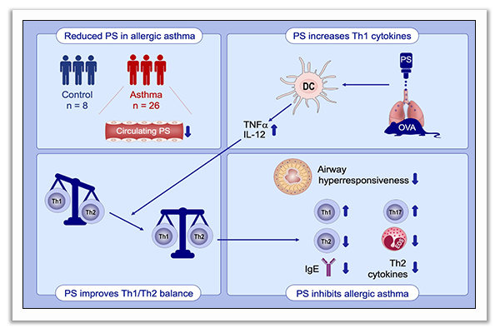
Protein S protects against allergic bronchial asthma by modulating Th1/Th2 balance
Kentaro Asayama, Tetsu Kobayashi, Corina N. D'Alessandro‐Gabazza, Masaaki Toda, Taro Yasuma, et al.
Allergy. 2020; 2267-2278 https://doi.org/10.1111/all.14261
© 2019 EAACI and John Wiley and Sons A/S. Published by John Wiley and Sons Ltd.
Notes:
HIGHLIGHTS
Patients with allergic bronchial asthma have reduced circulating level of active PS.
Administration of exogenous PS attenuates allergic airway inflammation and hyperresponsiveness in mice.
In the presence of protein S, allergen presentation by dendritic cells to T cells shifts the Th1/Th2 immune balance towards Th1 and inhibits allergic response in the airways, therefore PS has the potential to become a drug for the treatment of allergic bronchial asthma.
Abbreviations: OVA, ovalbumin; PS, protein S

