Slide 1
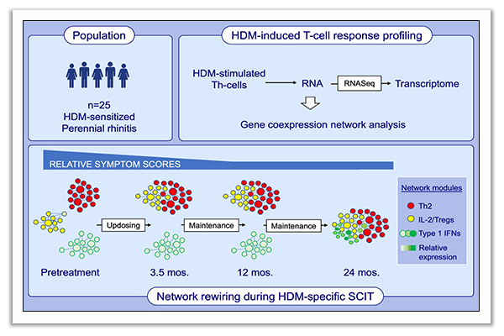
Rewiring of gene networks underlying mite allergen‐induced CD4 + Th‐cell responses during immunotherapy
Anya C. Jones, Denise Anderson, Niamh M. Troy, Dominic Mallon, Rochelle Hartmann, et al.
Allergy. 2020; 2330-2341 https://doi.org/10.1111/all.14265
© 2019 EAACI and John Wiley and Sons A/S. Published by John Wiley and Sons Ltd.
Notes:
HIGHLIGHTS
Gene coexpression networks underlying HDM-induced Th-cell responses in HDM-sensitized allergic rhinitis patients undergo a 2-stage “rewiring” process during 2-year HDM-SCIT treatment.
Early symptom reduction (during updosing) is associated with initial merging of Th2-effector and IL-2/T-regulatory network modules, without major quantitative changes in gene expression.
The 2nd phase (end of 2nd year) involves fusion with an upregulated type-1-interferon-signalling module, potentially stabilizing Th2-antagonistic treatment effects.
Abbreviation: HDM, house dust mite; SCIT, subcutaneous immunotherapy;
Th, T helper; Treg, T regulatory

