Slide 1
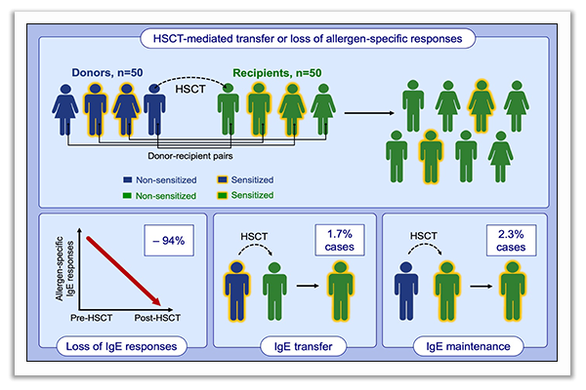
Transfer and loss of allergen‐specific responses via stem cell transplantation: A prospective observational study
Markus Debiasi, Herbert Pichler, Florian Klinglmüller, Heidrun Boztug, Klara Schmidthaler, et al.
Allergy. 2020; 2243-2253 https://doi.org/10.1111/all.14278
© 2019 EAACI and John Wiley and Sons A/S. Published by John Wiley and Sons Ltd.
Notes:
HIGHLIGHTS
In this prospective study, children and adolescents undergoing HSCT lost 94% of allergen-specific IgE responses after transplantation.
The risk of transferring or maintaining an allergen-specific IgE response by HSCT was 1,7% and 2,3%, respectively.
Donors and recipients should be assessed for allergic diseases before HSCT, and recipients should be followed-up by allergists in case of relevant IgE sensitizations in donors or recipients.
Abbreviation: HSCT, hematopoietic stem cell transplantation

