Slide 1
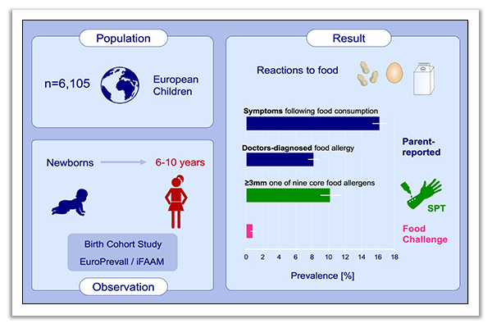
Frequency of food allergy in school‐aged children in eight European countries—The EuroPrevall‐iFAAM birth cohort
Linus Grabenhenrich, Valérie Trendelenburg, Johanna Bellach, Songül Yürek, Andreas Reich, et al.
Allergy. 2020; 2294-2308 https://doi.org/10.1111/all.14290
© 2019 EAACI and John Wiley and Sons A/S. Published by John Wiley and Sons Ltd.
Notes:
HIGHLIGHTS
Prospective observation of more than six thousand newborns estimated the frequency of food allergy, varying considerably by diagnostic approach.
One in ten children had positive skin prick against common food allergens, but only few actually suffered from food allergy.
This first multinational estimate of food allergy frequency challenges the widespread perception of an increase of allergic diseases.
Abbreviation: SPT, skin prick test

