Slide 1
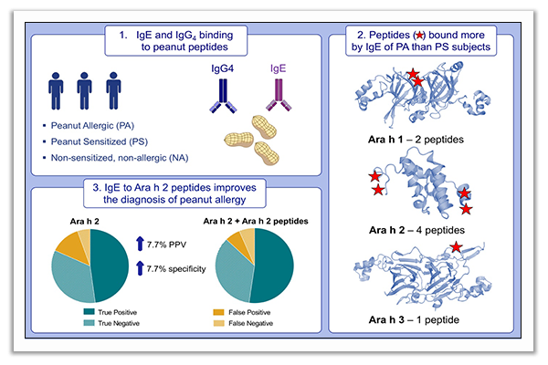
IgE to epitopes of Ara h 2 enhance the diagnostic accuracy of Ara h 2‐specific IgE
Alexandra F. Santos, Nuno L. Barbosa‐Morais, Barry K. Hurlburt, Sneha Ramaswamy, Oliver Hemmings, et al.
Allergy. 2020; 2309-2318 https://doi.org/10.1111/all.14301
© 2019 EAACI and John Wiley and Sons A/S. Published by John Wiley and Sons Ltd.
Notes:
HIGHLIGHTS
This study identifies differences in IgE and IgG4 binding to peanut peptides between peanut-allergic and peanut sensitized children.
Peanut peptide microarray analyses reveal that seven peptides
on Ara h 1, Ara h 2 and Ara h 3 are bound more by IgE of peanut-allergic compared to peanut-sensitized patients.
Measuring IgE to the Ara h 2 peptides in combination with Ara h2 enhances the diagnostic accuracy of Ara h 2-specific IgE.
Abbreviation: PPV, positive predictive value

