Slide 1
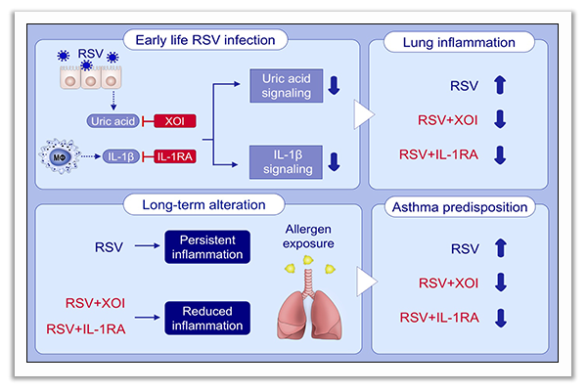
Inhibition of uric acid or IL‐1β ameliorates respiratory syncytial virus immunopathology and development of asthma
Charles F. Schuler IV, Carrie‐Anne Malinczak, Shannon K. K. Best, Susan B. Morris, Andrew J. Rasky, et al.
Allergy. 2020; 2279-2293 https://doi.org/10.1111/all.14310
© 2019 EAACI and John Wiley and Sons A/S. Published by John Wiley and Sons Ltd.
Notes:
HIGHLIGHTS
• Neonatal RSV infection is associated with increases in pulmonary uric acid and IL-1β and lung immunopathology.
• XOI or IL-1RA administration during neonatal RSV infection leads to reduced RSV immunopathology.
• XOI or IL-1RA administration during neonatal RSV infection leads to reduced type 2 immune responses during a subsequent model of asthma.
Abbreviations: IL-1RA, IL-1 receptor antagonist; RSV, respiratory syncytial virus;
XOI, xanthine oxidase inhibitor
.

