Slide 1
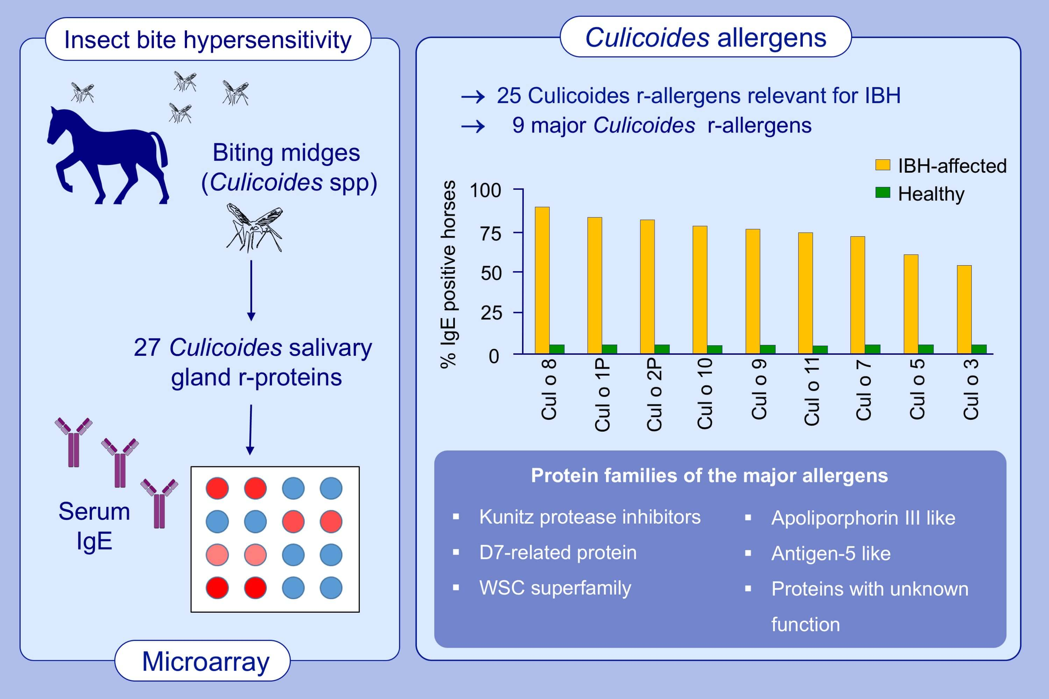
Component‐resolved microarray analysis of IgE sensitization profiles to Culicoides recombinant allergens in horses with insect bite hypersensitivity
Ella N. Novotny, Samuel J. White, A. Douglas Wilson, Sara B. Stefánsdóttir, Edwin Tijhaar, et al.
Allergy. 2021; 1147-1157 https://doi.org/10.1111/all.14556
© 2019 EAACI and John Wiley and Sons A/S. Published by John Wiley and Sons Ltd.
Notes:
HIGHLIGHTS
In this study, we identify and produce eight new Culicoides r- allergens, Cul o 8 to Cul o 15.
Out of 27 tested Culicoides r-allergens, nine are major allergens for IBH and seven bind serum IgE in >70% of the IBH-affected horses.
Combination of these seven r-allergens could diagnose >90% of IBH horses with a specificity >95%.
Abbreviations: IBH, equine insect bite hypersensivity; r-allergen/protein, recombinant allergen/protein

