Slide 1
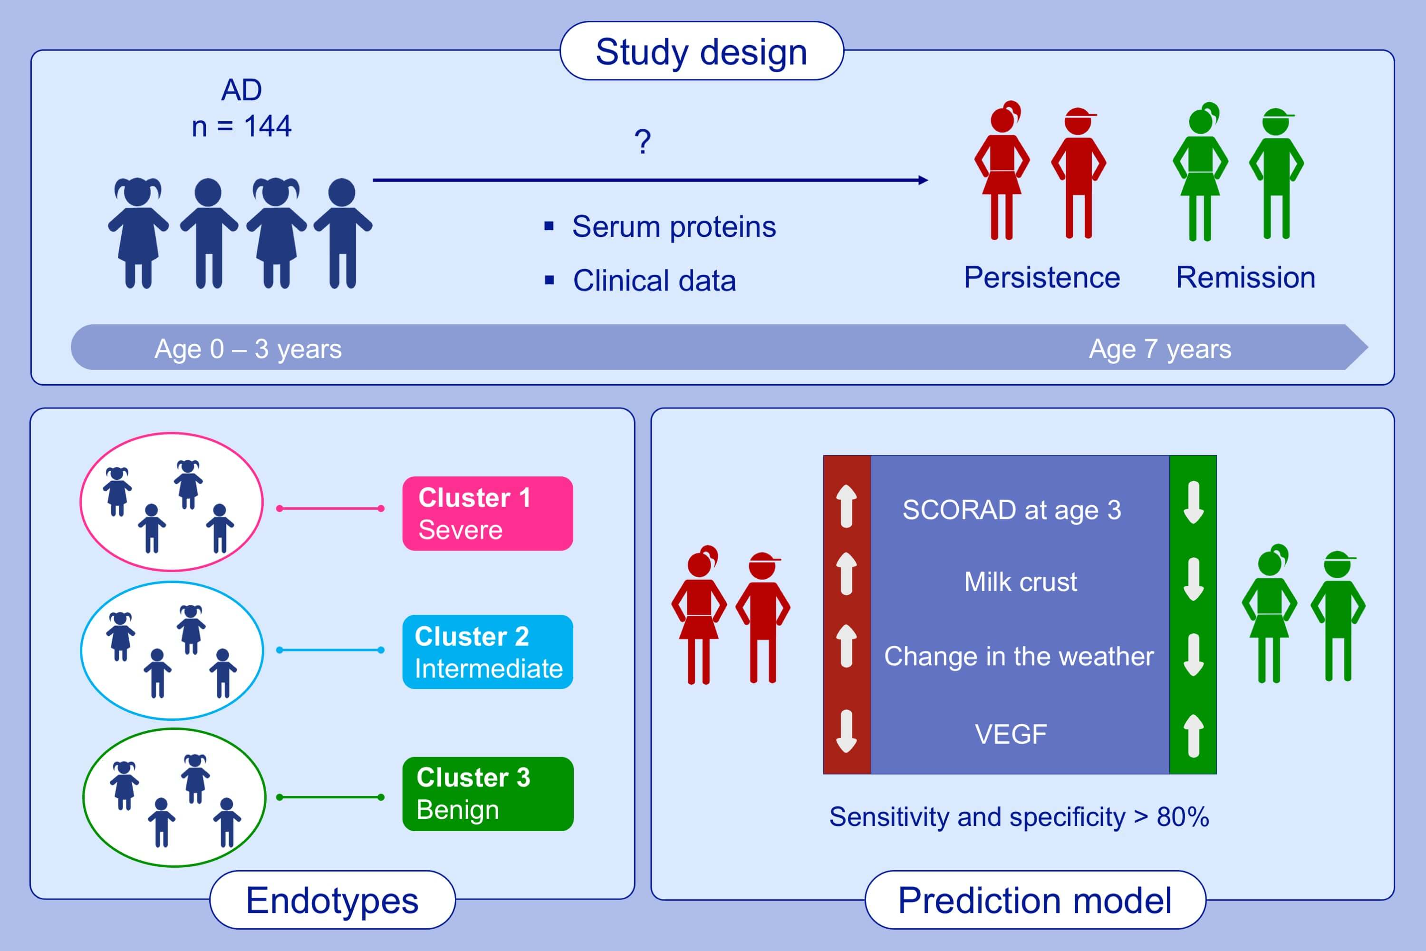
Predicting persistence of atopic dermatitis in children using clinical attributes and serum proteins
Felix Lauffer, Veronika Baghin, Marie Standl, Sebastian P. Stark, Manja Jargosch, et al.
Allergy. 2021; 1158-1172 https://doi.org/10.1111/all.14557
© 2019 EAACI and John Wiley and Sons A/S. Published by John Wiley and Sons Ltd.
Notes:
HIGHLIGHTS
Three distinct endotypes are found in infant AD.
Persistence of AD at the age of 7 years is predicted with a sensitivity and specificity > 80%.
Factors with a high impact on the prediction of persistence are SCORAD at the age of 3 years, milk crust, aggravation triggered by change in the weather and low VEGF serum levels.
Abbreviations: AD, atopic dermatitis; SCORAD, scoring of atopic dermatitis; VEGF, vascular endothelial growth factor

