Slide 1
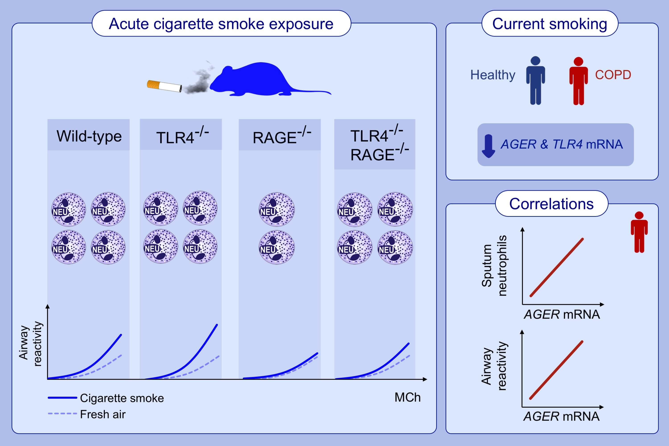
RAGE and TLR4 differentially regulate airway hyperresponsiveness: Implications for COPD
Venkata Sita Rama Raju Allam, Alen Faiz, Maggie Lam, Senani N. H. Rathnayake, Benedikt Ditz, et al.
Allergy. 2021; 1123-1135 https://doi.org/10.1111/all.14563
© 2019 EAACI and John Wiley and Sons A/S. Published by John Wiley and Sons Ltd.
Notes:
HIGHLIGHTS
In mice, the absence of RAGE protects against neutrophilia and increased airway reactivity induced by acute smoke exposure, but this protection is largely lost when TLR4 is also absent.
In humans, smoking is associated with lower AGER (encodes RAGE) and TLR4 expression irrespective of COPD status
AGER gene expression correlates with neutrophilic inflammation and more severe airway hyperresponsiveness in COPD patients.
Abbreviations: AGER, advanced glycation end product receptor; COPD, chronic obstructive pulmonary disease; MCh, methacholine; RAGE, receptor for advanced glycation end products; TLR4, toll-like receptor 4

