Slide 1
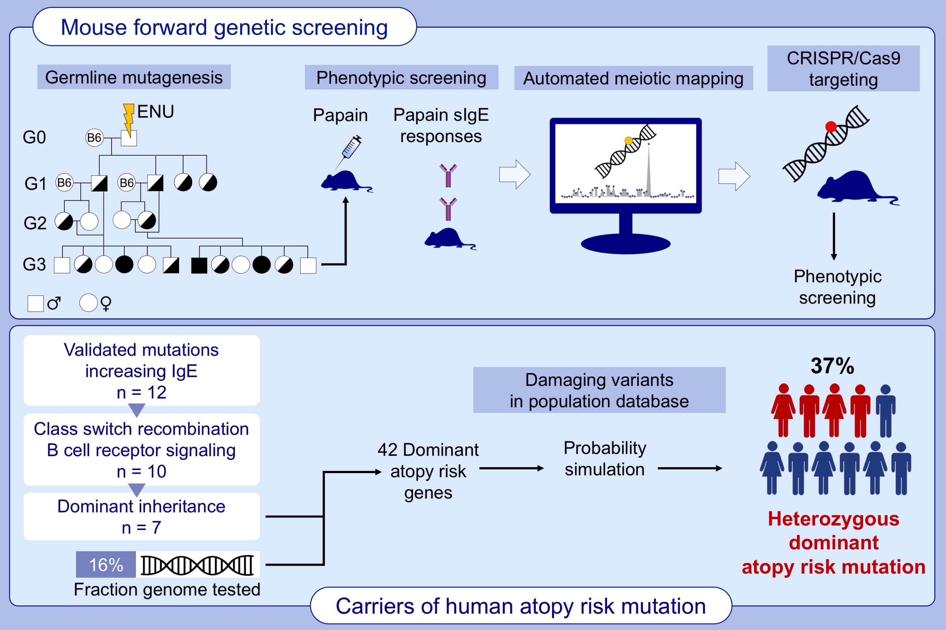
Dominant atopy risk mutations identified by mouse forward genetic analysis
Jeffrey A. SoRelle, Zhe Chen, Jianhui Wang, Tao Yue, Jin Huk Choi, et al.
Allergy. 2021; 1095-1108 https://doi.org/10.1111/all.14564
© 2019 EAACI and John Wiley and Sons A/S. Published by John Wiley and Sons Ltd.
Notes:
HIGHLIGHTS
This study uses a classical genetic screen employing automated meiotic mapping of pre-genotyped mice and CRISPR/Cas9-based verification to identify numerous mutations causing altered IgE responses to papain immunization.
Three-quarters of mutations that increased allergen-specific IgE are dominant or semidominant, without causing immunodeficiency in the heterozygous state.
Up to 37% of immunocompetent humans may carry a heterozygous, dominant atopy risk mutation.
Abbreviations: CRISPR, clustered regularly interspaced short palindromic repeats; ENU, N-ethyl-N-nitrosourea.

