Slide 1
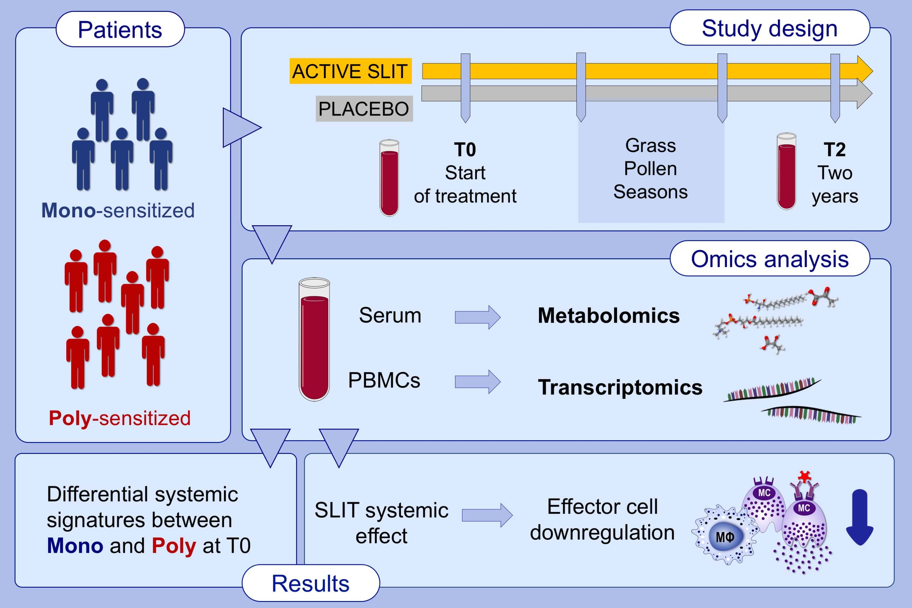
Exploring novel systemic biomarker approaches in grass‐pollen sublingual immunotherapy using omics
Tomas Clive Barker‐Tejeda, Raphaelle Bazire, David Obeso, Leticia Mera‐Berriatua, Domenico Rosace, et al.
Allergy. 2021; 1199-1212 https://doi.org/10.1111/all.14565
© 2019 EAACI and John Wiley and Sons A/S. Published by John Wiley and Sons Ltd.
Notes:
HIGHLIGHTS
In this study, omics strategies are used to identify mechanisms underlying SLIT in a prospective, double-blind, placebo-controlled study.
The systemic effect induced by 2 years of SLIT is mediated by the downregulation of effector cells.
Mono- and poly-sensitized patients present differential systemic inflammatory signatures before starting SLIT.
Abbreviations: SLIT, sublingual allergen-specific immunotherapy; PBMCs, peripheral blood mononuclear cells

