Slide 1
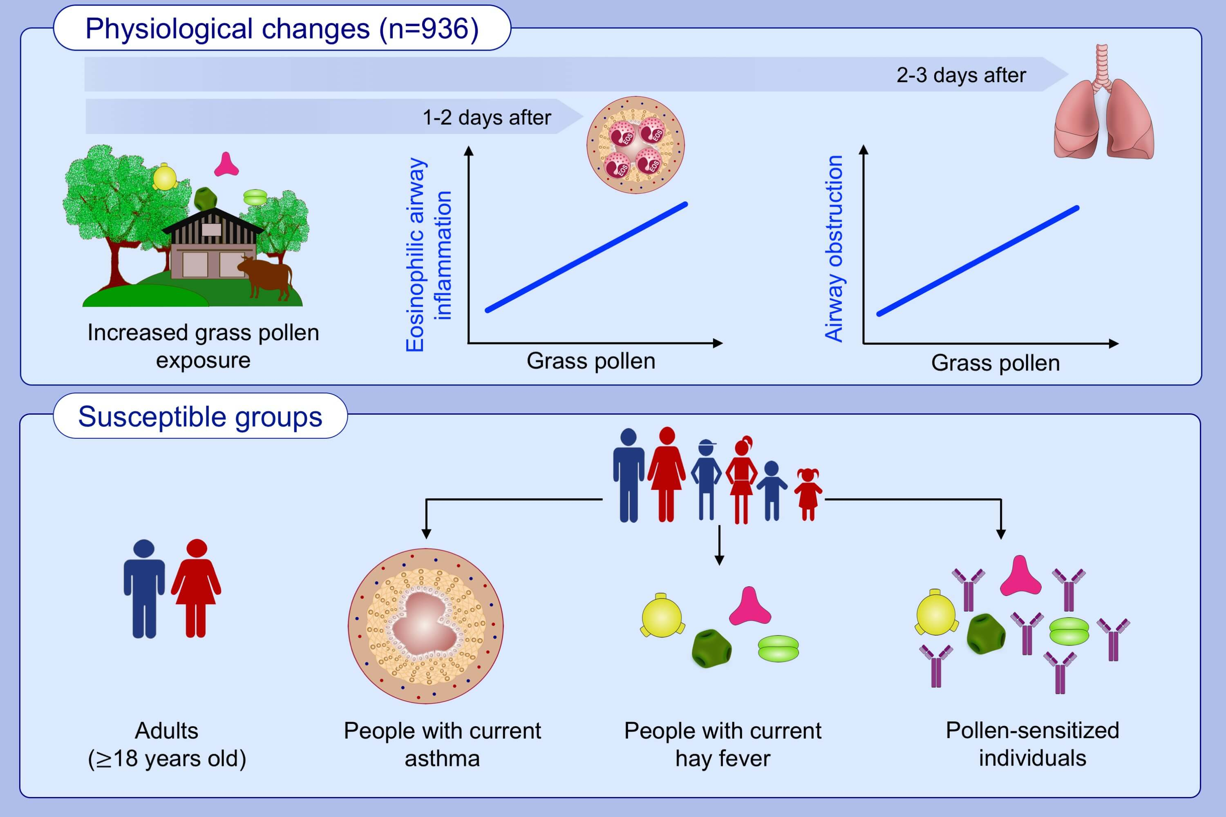
Is short‐term exposure to grass pollen adversely associated with lung function and airway inflammation in the community?
Nur Sabrina Idrose, Rachel C. A. Tham, Caroline J. Lodge, Adrian J. Lowe, Dinh Bui, et al.
Allergy. 2021; 1136-1146 https://doi.org/10.1111/all.14566
© 2019 EAACI and John Wiley and Sons A/S. Published by John Wiley and Sons Ltd.
Notes:
HIGHLIGHTS
This study investigates a community-based sample of 936 participants.
Grass pollen exposure is associated with eosinophilic airway inflammation 1-2 days after exposure and airway obstruction 2-3 days after exposure.
Adults and individuals with current asthma with hay fever and/or pollen sensitization may be at a higher risk and therefore represent a target population for interventional studies.

