Slide 1
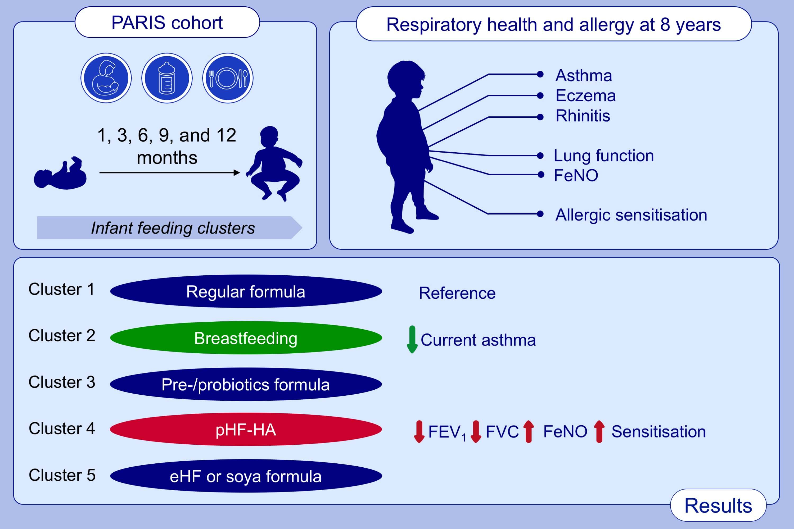
Infant feeding clusters are associated with respiratory health and allergy at school age in the PARIS birth cohort
Hélène Amazouz, Blandine de Lauzon‐Guillain, Mélisande Bourgoin‐Heck, Jocelyne Just, Nicole Beydon, et al.
Allergy. 2021; 1223-1234 https://doi.org/10.1111/all.14568
© 2019 EAACI and John Wiley and Sons A/S. Published by John Wiley and Sons Ltd.
Notes:
HIGHLIGHTS
This study identifies 5 infant feeding clusters based on three main features of infant feeding (breastfeeding, infant formula, solid food introduction).
Cluster 2 (27.2% of infants) includes infants exclusively breastfed during the first 3 months, who are less likely to have asthma at 8 years compared to infants mainly fed with regular formula.
Cluster 4 (7.3%) includes infants using pHF-HA at 3 months, who have lower lung function, higher FeNO and higher risk of sensitisation at 8 years compared to infants fed with regular formula.
Abbreviations: eHF, extensively hydrolysed formula; FeNO, fractional exhaled nitric oxide; FEV₁, forced expiratory volume in one second; FVC, forced vital capacity; pHF-HA, partially hydrolysed formula with hypoallergenic label
.

