Slide 1
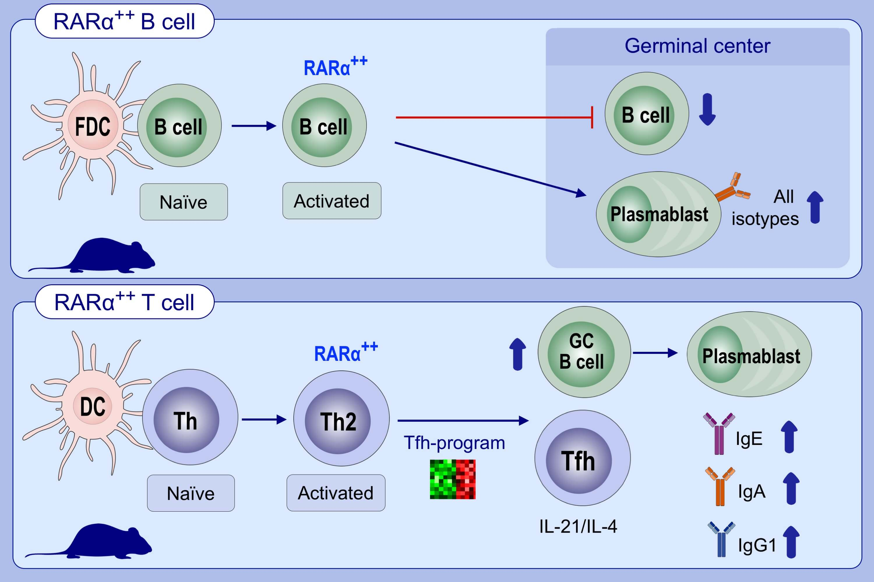
Vitamin A controls the allergic response through T follicular helper cell as well as plasmablast differentiation
Josephine Scholz, Julia Kuhrau, Frederik Heinrich, Gitta Anne Heinz, Andreas Hutloff, et al.
Allergy. 2021; 1109-1122 https://doi.org/10.1111/all.14581
© 2019 EAACI and John Wiley and Sons A/S. Published by John Wiley and Sons Ltd.
Notes:
HIGHLIGHTS
This study analyzes antigen-specific B and T lymphocytes in an adoptive transfer airway inflammation mouse model in response to 9-cis retinoic acid (9cRA) and after lymphocyte-specific genetic targeting of the receptor RARα.
RARα-overexpression in antigen-specific B cells promotes differentiation into plasmablasts at the expense of germinal center B cells.
In antigen-specific T cells, RARα strongly promotes the differentiation of T follicular helper cells followed by an enhanced germinal center response.
s
Abbreviations: FDC, follicular dendritic cell; GC, germinal center; Tfh, T follicular helper cell; RARα, retinoic acid receptor alpha

