Slide 1
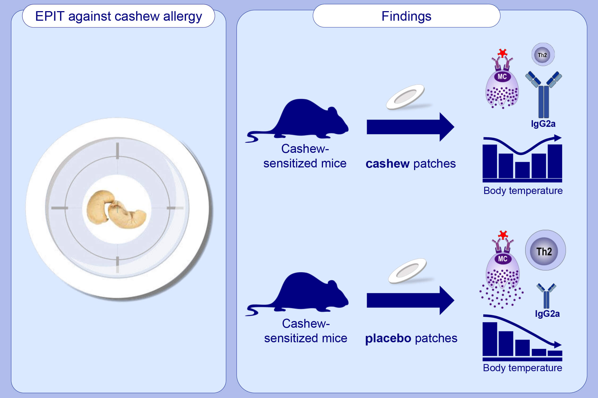
Epicutaneous immunotherapy protects cashew‐sensitized mice from anaphylaxis
Benjamin Pelletier, Audrey Perrin, Noémie Assoun, Camille Plaquet, Nathalie Oreal, et al.
Allergy. 2021; 1213-1222 https://doi.org/10.1111/all.14605
© 2019 EAACI and John Wiley and Sons A/S. Published by John Wiley and Sons Ltd.
Notes:
HIGHLIGHTS
This study demonstrates a newly-developed robust mouse model of IgE-mediated cashew anaphylaxis.
Cashew-sensitized mice are treated with epicutaneous patches containing cashew protein extract (cashew patches) or excipient (placebo patches) for 16 weeks.
Mice treated with cashew patches present a decrease in cashew-specific Th2 response and a decrease in mast cell reactivity and anaphylaxis symptoms following oral challenge.
Abbreviation: EPIT, epicutaneous immunotherapy

