Slide 1
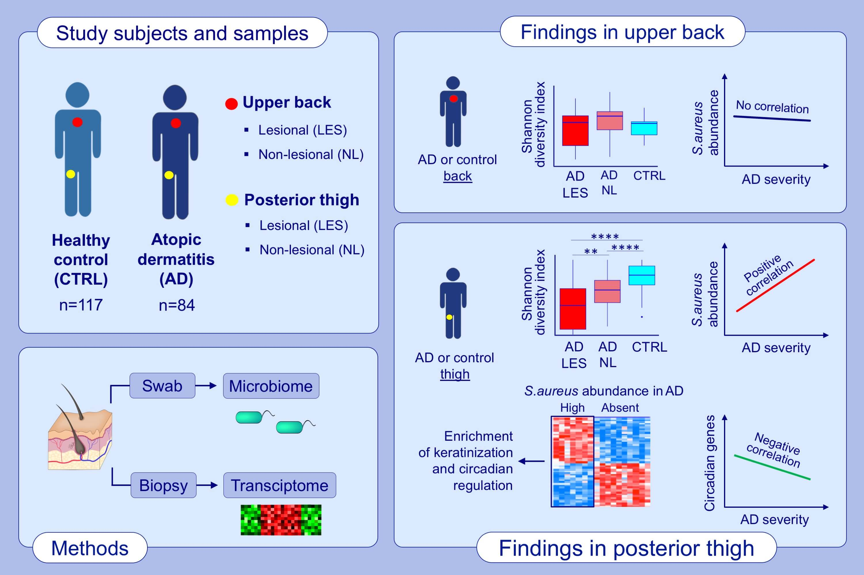
Microbial and transcriptional differences elucidate atopic dermatitis heterogeneity across skin sites
Noora Ottman, Mauricio Barrientos‐Somarribas, Nanna Fyhrquist, Helen Alexander, Lukas Wisgrill, et al.
Allergy. 2021; 1173-1187 https://doi.org/10.1111/all.14606
© 2019 EAACI and John Wiley and Sons A/S. Published by John Wiley and Sons Ltd.
Notes:
HIGHLIGHTS
Distinct disease-related gene expression profiles depend on anatomical location - keratinization is dominating in the posterior thigh and lipid metabolism in the upper back.
Relative abundance of Staphylococcus aureus is associated with disease severity in the posterior thigh, but not in the upper back.
The abundance of S. aureus in posterior thigh is associated with keratinization and circadian rhythm regulating genes.

