Slide 1
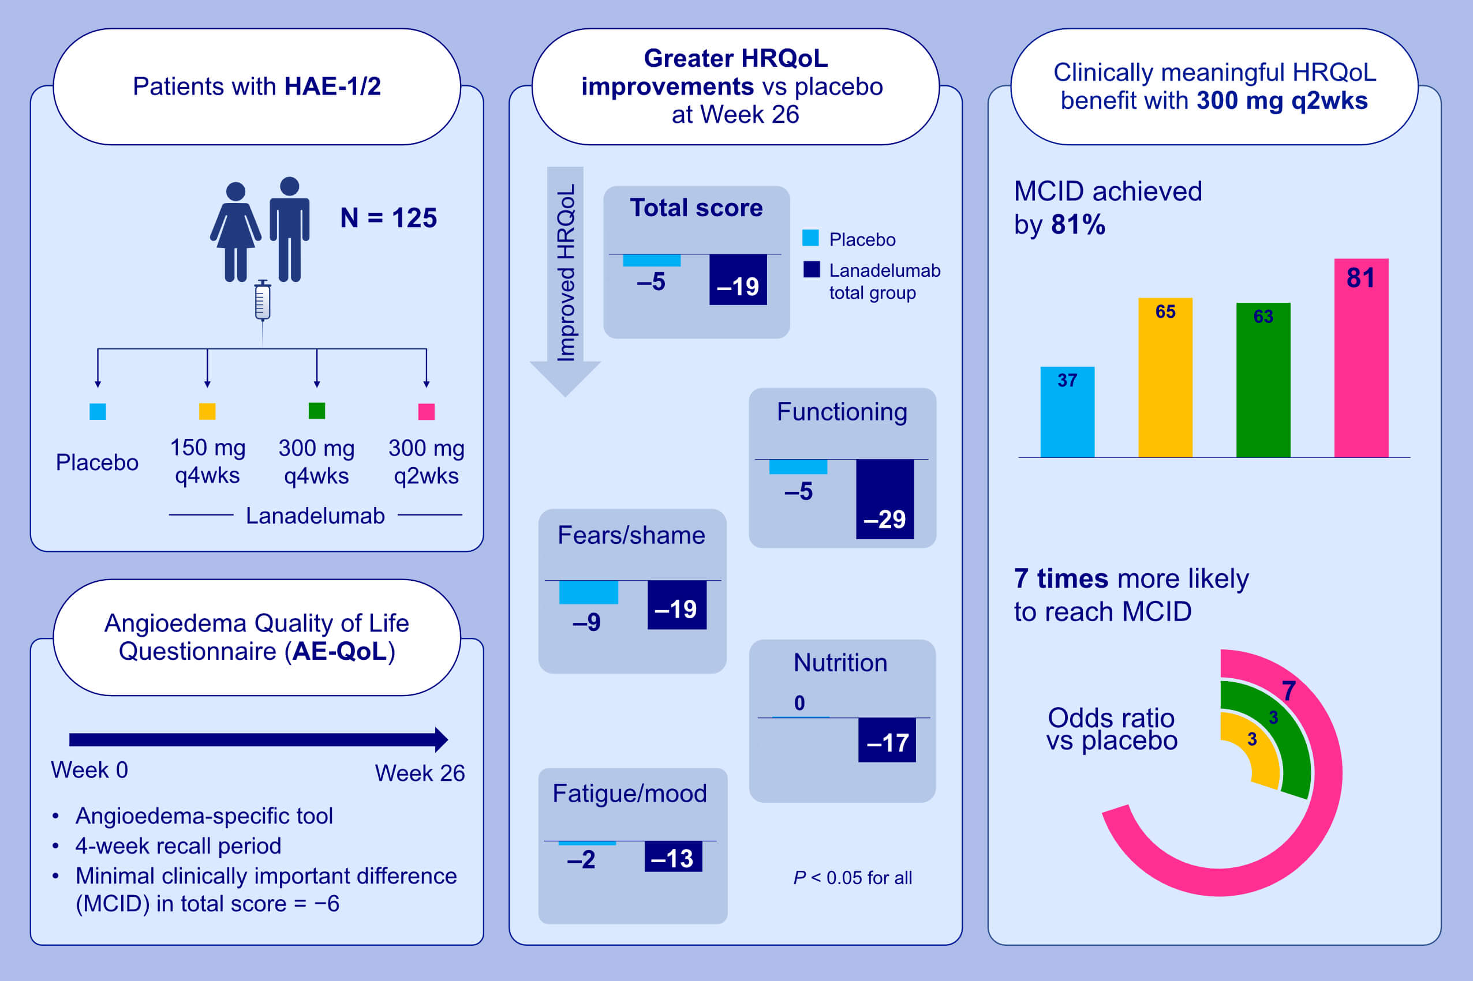
Impact of lanadelumab on health‐related quality of life in patients with hereditary angioedema in the HELP study
William R. Lumry, Karsten Weller, Markus Magerl, Aleena Banerji, Hilary J. Longhurst, et al.
Allergy. 2021; 1188-1198 https://doi.org/10.1111/all.14680
© 2019 EAACI and John Wiley and Sons A/S. Published by John Wiley and Sons Ltd.
Notes:
HIGHLIGHTS
In the phase 3 HELP Study, HRQoL of patients with HAE-1/2 was evaluated using the angioedema-specific AE-QoL.
After 26 weeks, lanadelumab-treated patients experienced significantly greater HRQoL improvements than placebo-treated patients.
Patients receiving lanadelumab 300 mg q2wks were most likely to see clinically meaningful benefit, with 81% reaching the MCID and seven times greater odds versus placebo for this achievement.
Abbreviations: AE-QoL, Angioedema Quality of Life Questionnaire; HAE, hereditary angioedema; HRQoL, health-related quality of life; MCID, minimal clinically important difference; q2wks, every 2 weeks; q4wks, every 4 weeks

