Slide 1
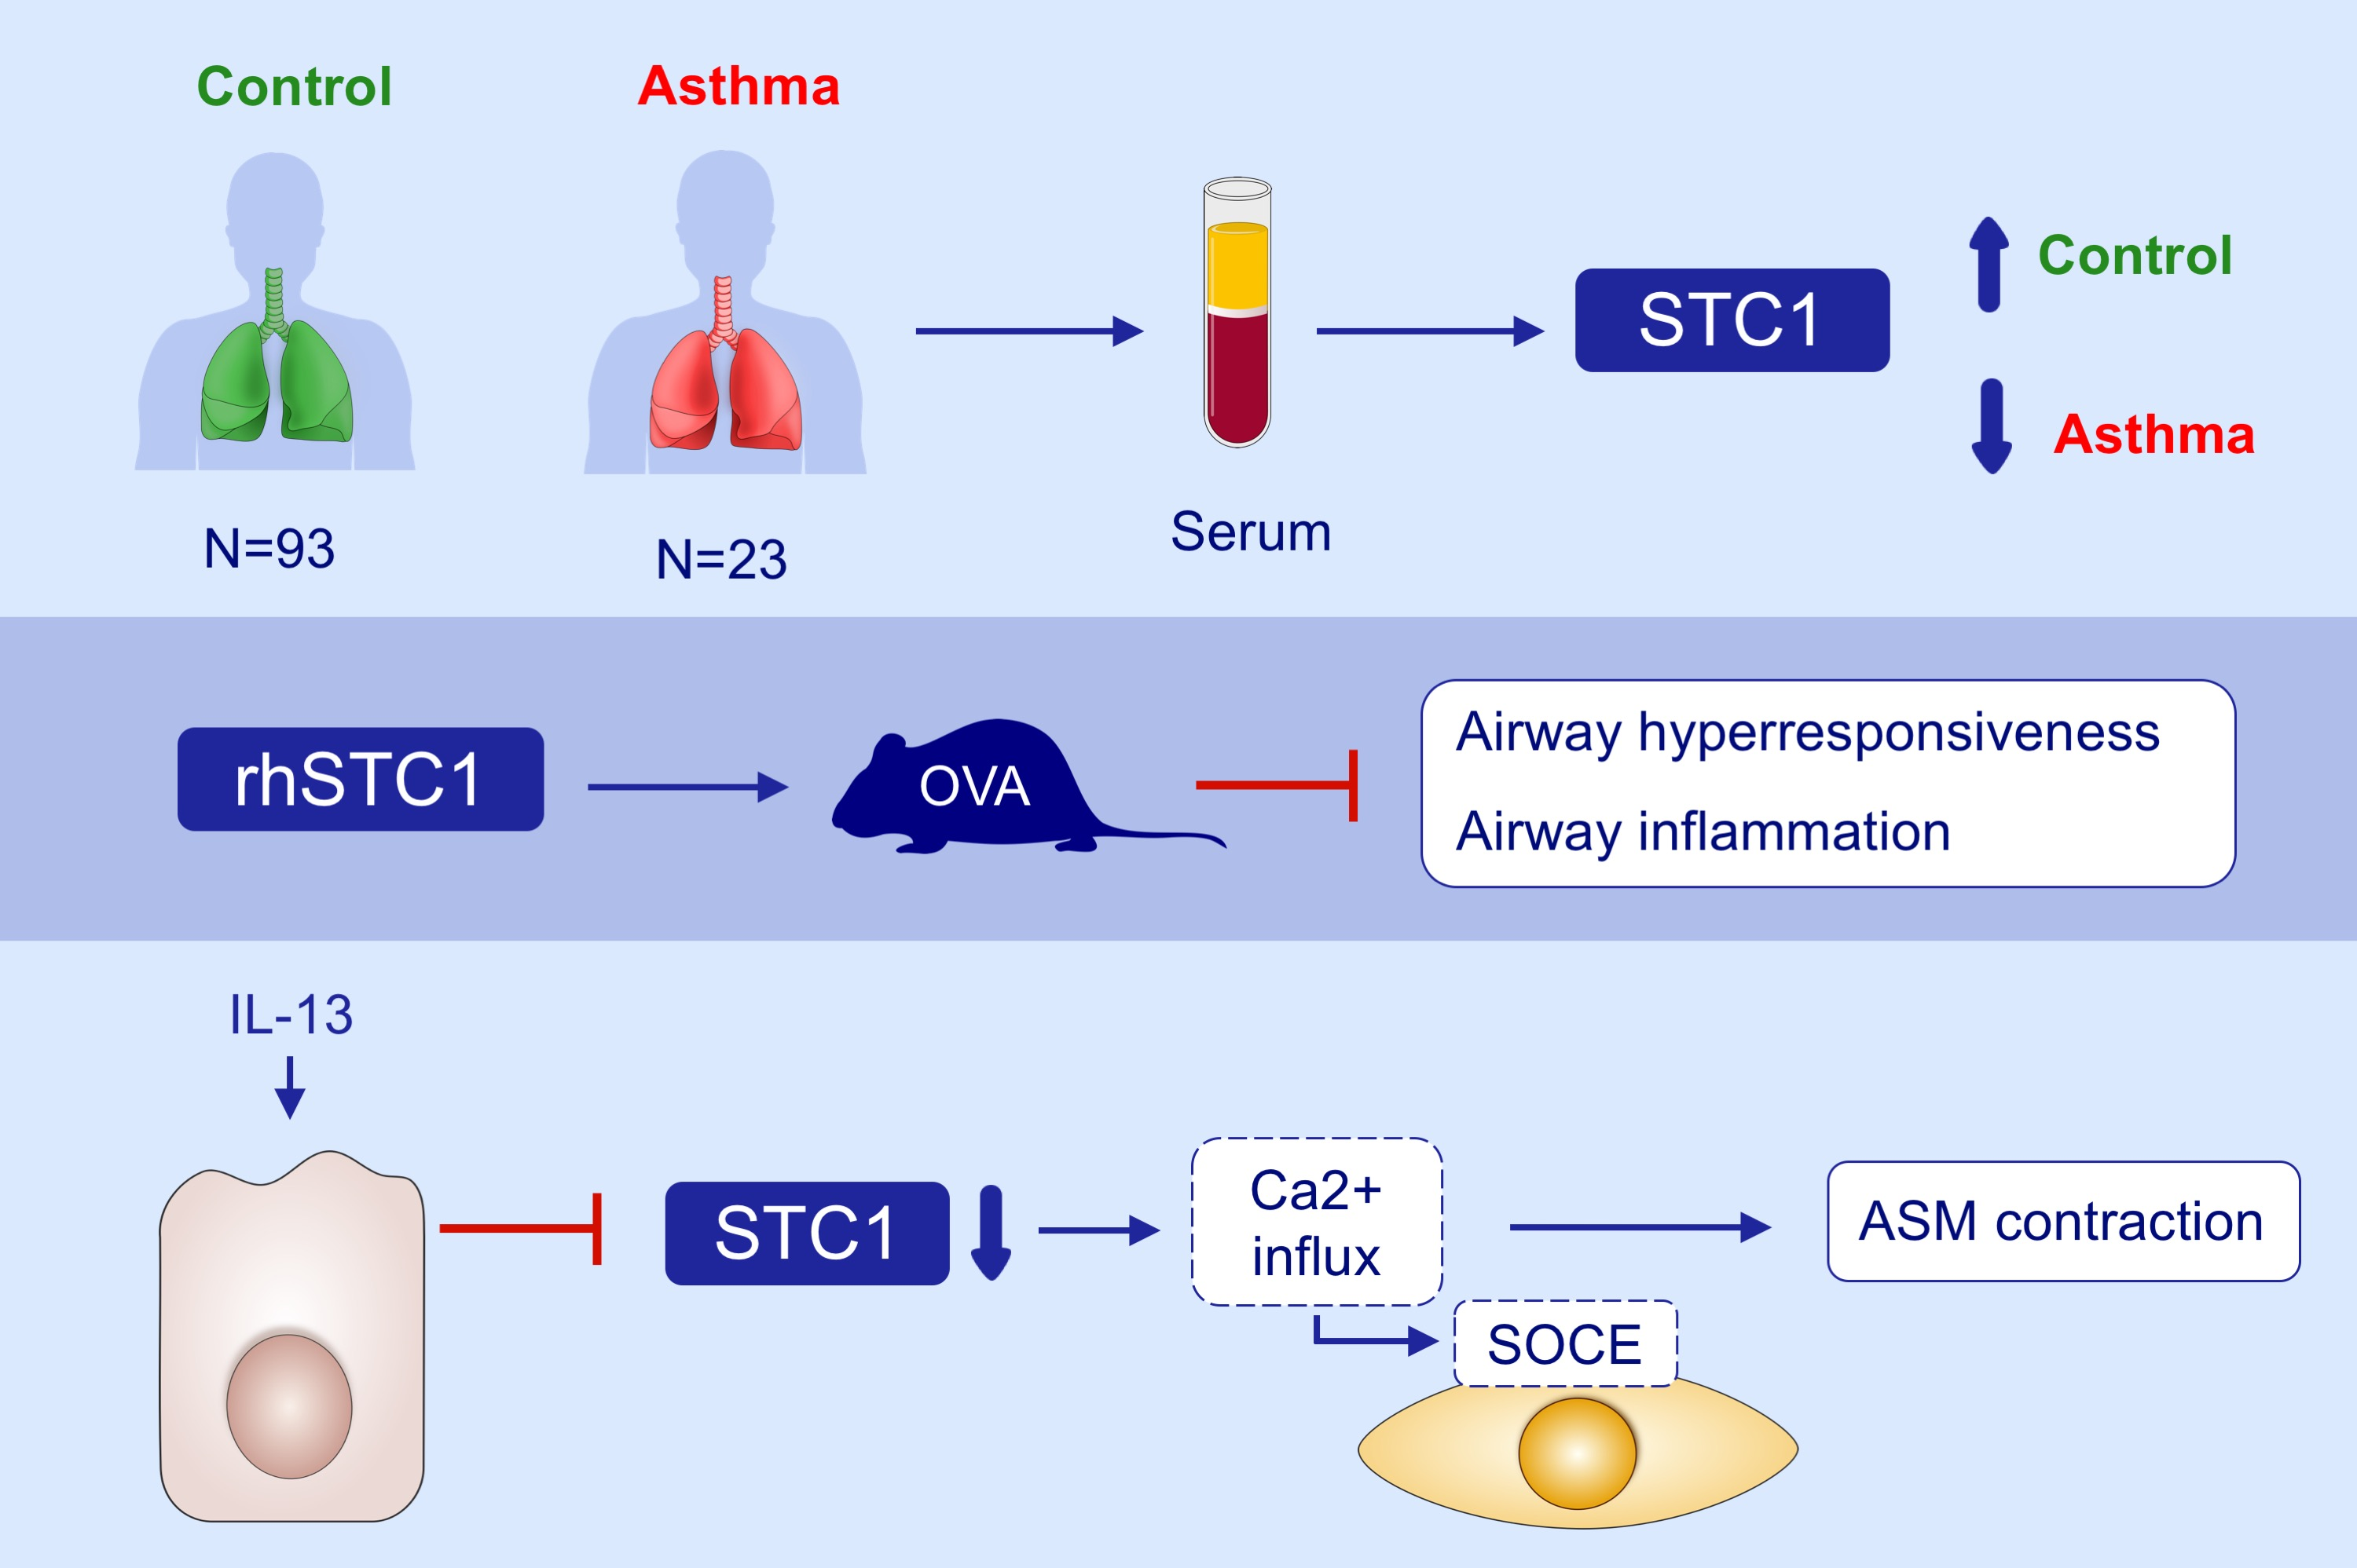
Epithelial expression and role of secreted STC1 on asthma airway hyperresponsiveness through calcium channel modulation
Jiayan Xu,, Yaqi Meng,, Man Jia,, Jie Jiang,, Yi Yang,, et al.
Allergy. 2021; 2475-2487 https://doi.org/10.1111/all.14727
© 2019 EAACI and John Wiley and Sons A/S. Published by John Wiley and Sons Ltd.
Notes:
HIGHLIGHTS
Serum levels of STC1 were decreased in asthma and correlated with asthma control and lung function.
STC1 was mainly expressed in the bronchial epithelium and intranasal administration of rhSTC1 reduced AHR and inflammation in mice.
IL-13 suppressed STC1 release from 16HBE cells, whereas rhSTC1 blocked SOCE by suppressing STIM1 and further inhibited ASM cell contractility.
Abbreviations: 16HBE, human bronchial epithelial cell line; AHR, airway hyperresponsiveness; ASM, airway smooth muscle; OVA, ovalbumin; rhSTC1, recombinant human STC1; SOCE, store-operated Ca2+ entry; STC1, stanniocalcin-1; STIM1, stromal interaction molecule 1

