Slide 1
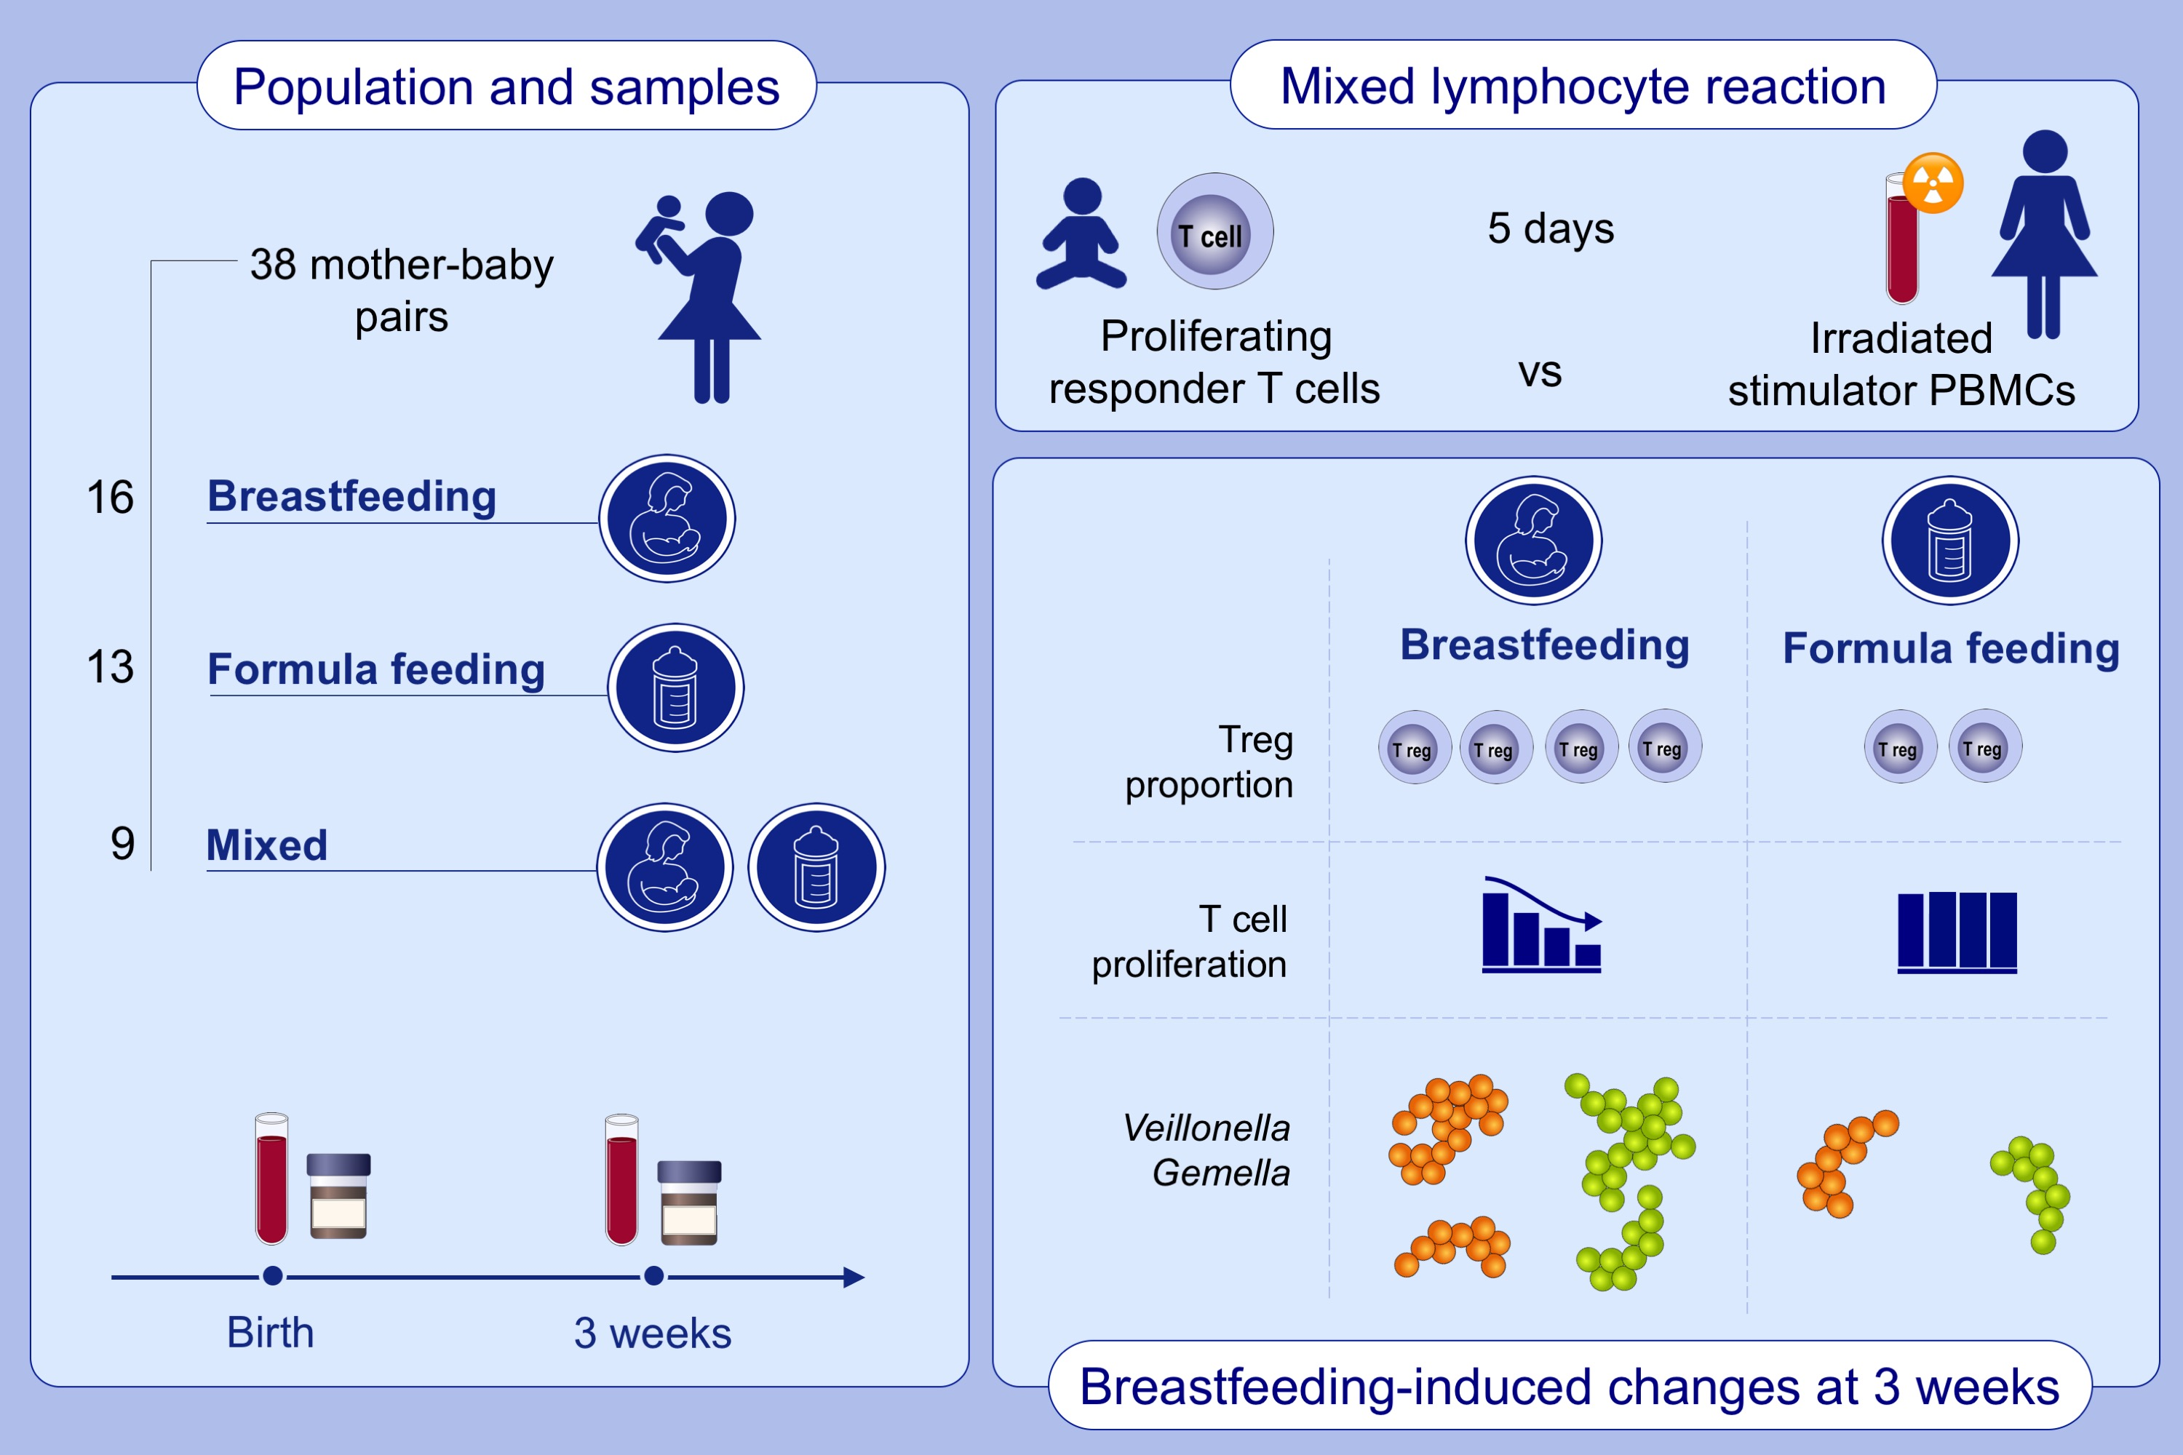
Breastfeeding promotes early neonatal regulatory T-cell expansion and immune tolerance of non-inherited maternal antigens
Hannah Wood,, Animesh Acharjee,, Hayden Pearce,, Mohammed Nabil Quraishi,, Richard Powell,, et al.
Allergy. 2021; 2447-2460 https://doi.org/10.1111/all.14736
© 2019 EAACI and John Wiley and Sons A/S. Published by John Wiley and Sons Ltd.
Notes:
HIGHLIGHTS
The proportion of Tregs is nearly two-fold higher in exclusively breastfed neonates compared to those who received formula milk only.
Breastfed neonates show a specific and Treg-dependent reduction in proliferative T cell responses to non-inherited maternal antigens.
Short chain fatty acid producing taxa (Veillonella and Gemella) are enriched in stool samples of exclusively breastfed neonates.
Abbreviations: PBMC, peripheral blood mononuclear cell; Treg, regulatory T cell

