Slide 1
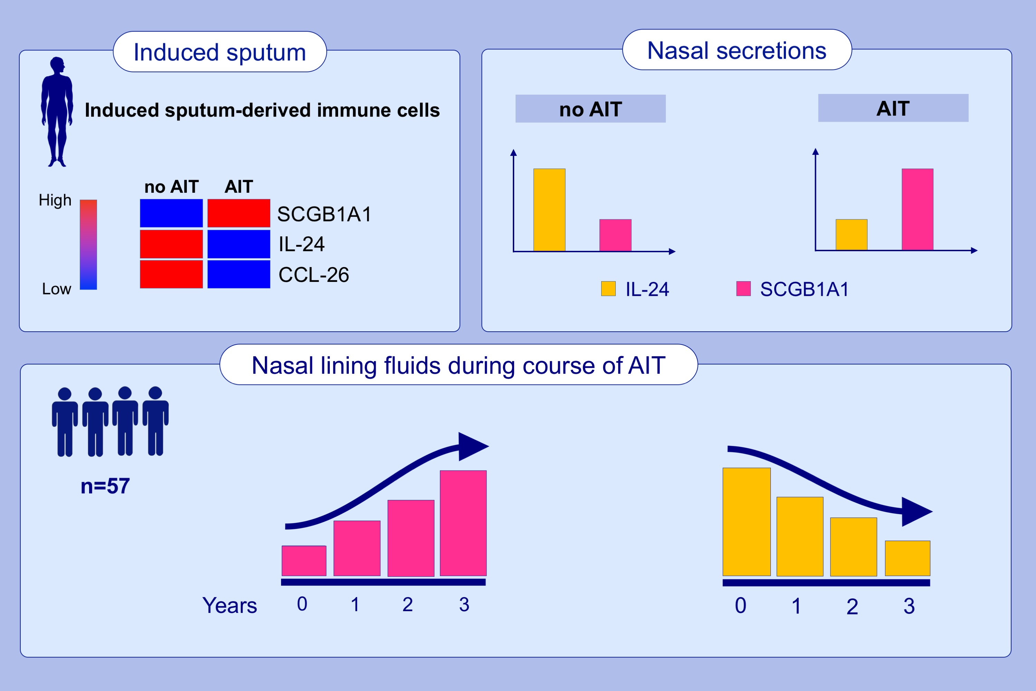
Allergen-specific immunotherapy induces the suppressive secretoglobin 1A1 in cells of the lower airways
Ulrich M. Zissler,, Constanze A. Jakwerth,, Ferdinand Guerth,, Larissa Lewitan,, Sandra Rothkirch,, et al.
Allergy. 2021; 2461-2474 https://doi.org/10.1111/all.14756
© 2019 EAACI and John Wiley and Sons A/S. Published by John Wiley and Sons Ltd.
Notes:
HIGHLIGHTS
AIT inhibited pro-inflammatory CXCL8, IL24 and CCL26 mRNA expression in alveolar sputum cells.
SCGB1A1 was induced in lower airway cells independently of the asthma status and allergen season.
The epithelial type-2 (E2) cytokine IL-24 was reduced following three years of AIT-treatment, while SCGB1A1 was significantly increased and identified as a suppressor of epithelial gene expression.
Abbreviations: AIT, allergen-specific immunotherapy; CCL, C-C motif chemokine ligand; CXCL, C-X-C motif chemokine ligand; SCGB1A1, secretoglobin 1A1

