Slide 1
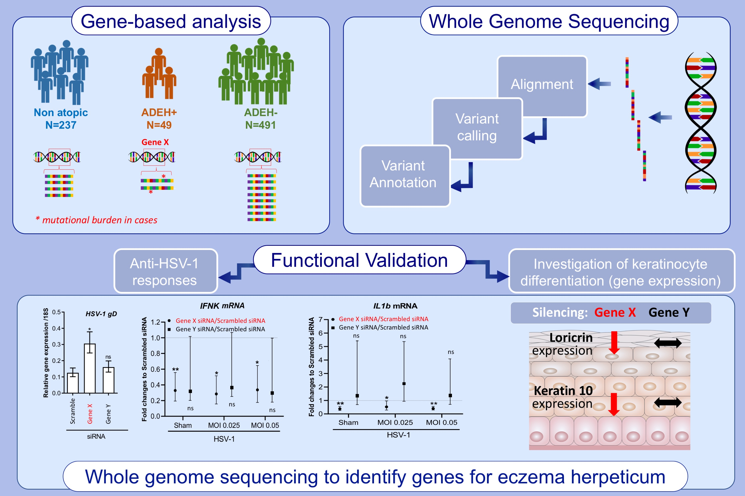
Whole genome sequencing identifies novel genetic mutations in patients with eczema herpeticum
Lianghua Bin,, Claire Malley,, Patricia Taylor,, Meher Preethi Boorgula,, Sameer Chavan,, et al.
Allergy. 2021; 2510-2523 https://doi.org/10.1111/all.14762
© 2019 EAACI and John Wiley and Sons A/S. Published by John Wiley and Sons Ltd.
Notes:
HIGHLIGHTS
Whole Genome Sequencing was used to search genomewide for deleterious genetic variants that are differentially enriched in ADEH+ compared to ADEH- and non-atopic controls.
A gene-based comparison between cases and controls was used prioritize genes enriched for such variants to be followed up for functional validation.
Functional validation reveals two genes: SIDT2 and RBBP8NL are involved in keratinocyte differentiation and responses against HSV-1 infection.
Abbreviations: AD, atopic dermatitis; ADEH+, atopic dermatitis with a history of eczema herpeticum; ADEH-, atopic dermatitis without a history of eczema herpeticum; HSV-1, herpes simplex virus-1; IFN, interferon; RBBP8NL, RBBP8 N-terminal-like; SIDT2, SID1 transmembrane family member 2; siRNA, small interfering RNA

