Slide 1
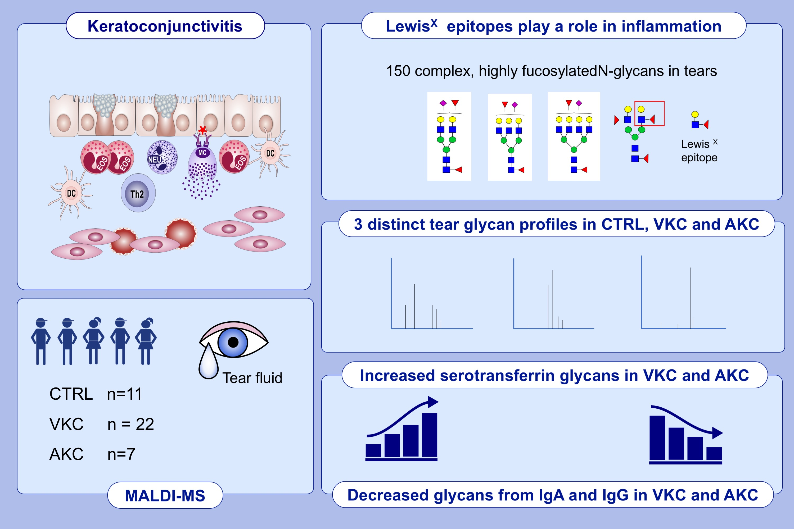
Tear N-glycomics in vernal and atopic keratoconjunctivitis
Angela Messina,, Angelo Palmigiano,, Claudia Tosto,, Donata Agata Romeo,, Luisa Sturiale,, et al.
Allergy. 2021; 2500-2509 https://doi.org/10.1111/all.14775
© 2019 EAACI and John Wiley and Sons A/S. Published by John Wiley and Sons Ltd.
Notes:
HIGHLIGHTS
Using MALDI-TOF MS and MALDI-TOF MS/MS techniques, we identify more than 150 different N-glycans in the tear fluid, with Lewis^{X} epitopes playing a role in inflammation.
There are distinct and unique N-glycome profiles in tear fluid from CTRL, VKC and AKC.
Increased intensities of peaks refer to glycans from serotransferrin in VKC and AKC, and decreased intensity of peaks - to IgG and IgA in VKC and AKC compared to CTRL.
Abbreviations: MALDI-TOF, matrix assisted laser desorption ionization; AKC, atopic keratoconjunctivitis; CTLR, control; MS, mass spectrometry; VKC, vernal keratoconjunctivitis

