Slide 1
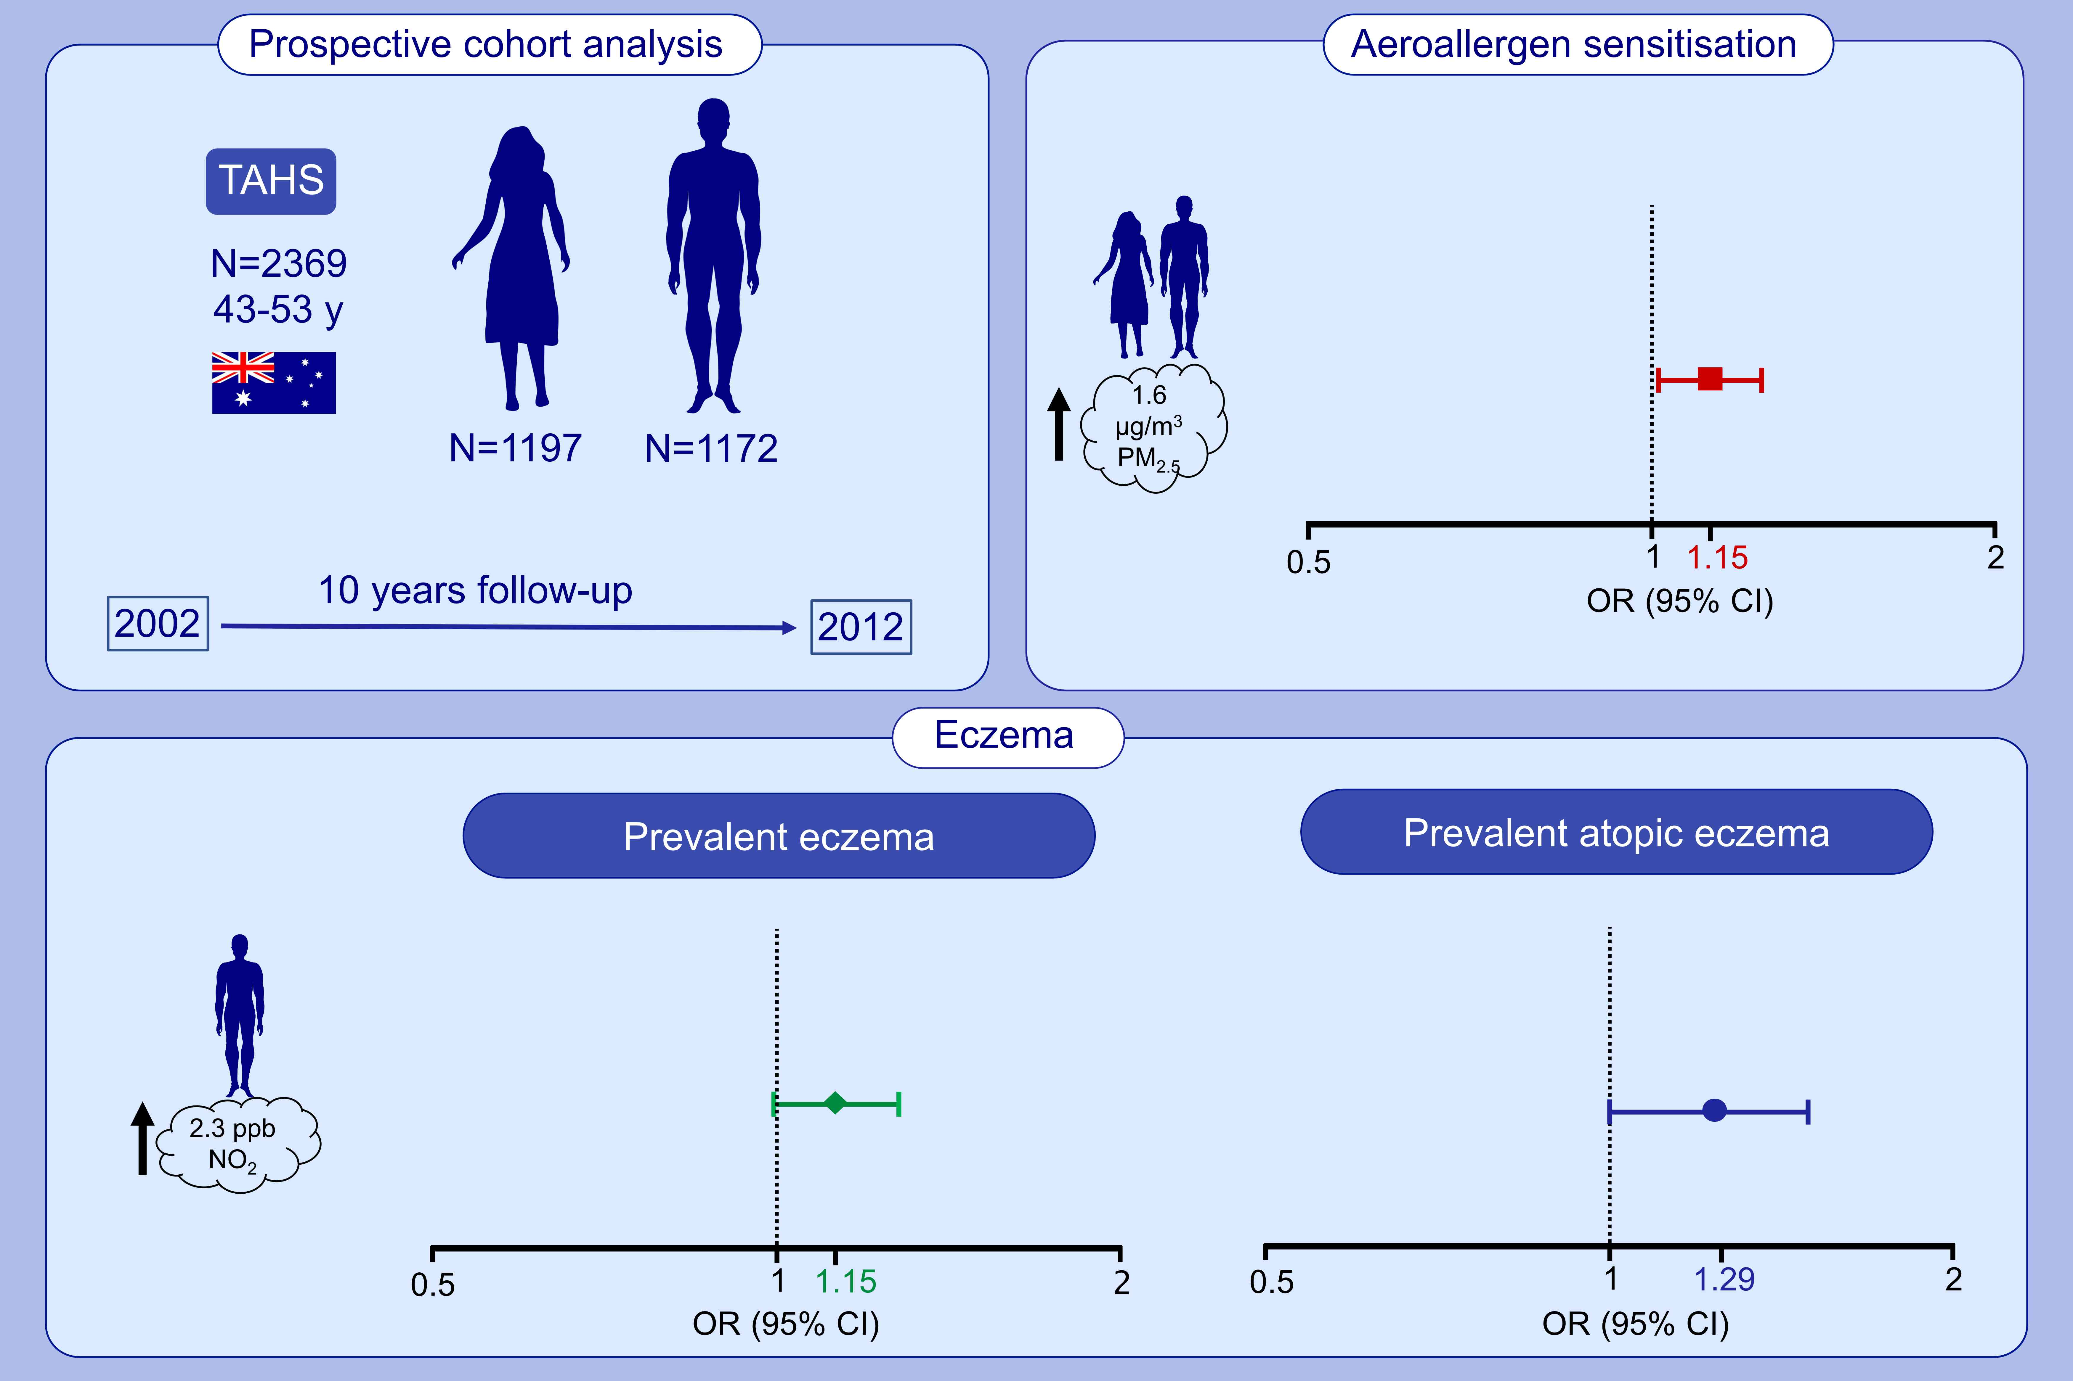
Association between ambient air pollution and development and persistence of atopic and non-atopic eczema in a cohort of adults
Diego J. Lopez,, Caroline J. Lodge,, Dinh S. Bui,, Nilakshi T. Waidyatillake,, John C. Su,, et al.
Allergy. 2021; 2524-2534 https://doi.org/10.1111/all.14783
© 2019 EAACI and John Wiley and Sons A/S. Published by John Wiley and Sons Ltd.
Notes:
HIGHLIGHTS
In this population-based prospective cohort study in Australia, we evaluate air pollution association with eczema and allergic sensitisation.
After 10 years of follow-up, a 1.6 µg/m³ increase in PM_{2.5} exposure is associated with increased odds of aeroallergen sensitisation in both sexes.
In males, a 2.3 ppb increase in NO₂ is associated with increased odds of prevalent eczema and atopic eczema.
Abbreviations: CI, confidence interval; NO₂, nitrogen dioxide; OR, odds ratio; PM_{2.5}, particulate matter with an aerodynamic diameter of 2.5 µm or less; ppb, parts per billion; TAHS, Tasmanian Longitudinal Health Study

