Slide 1
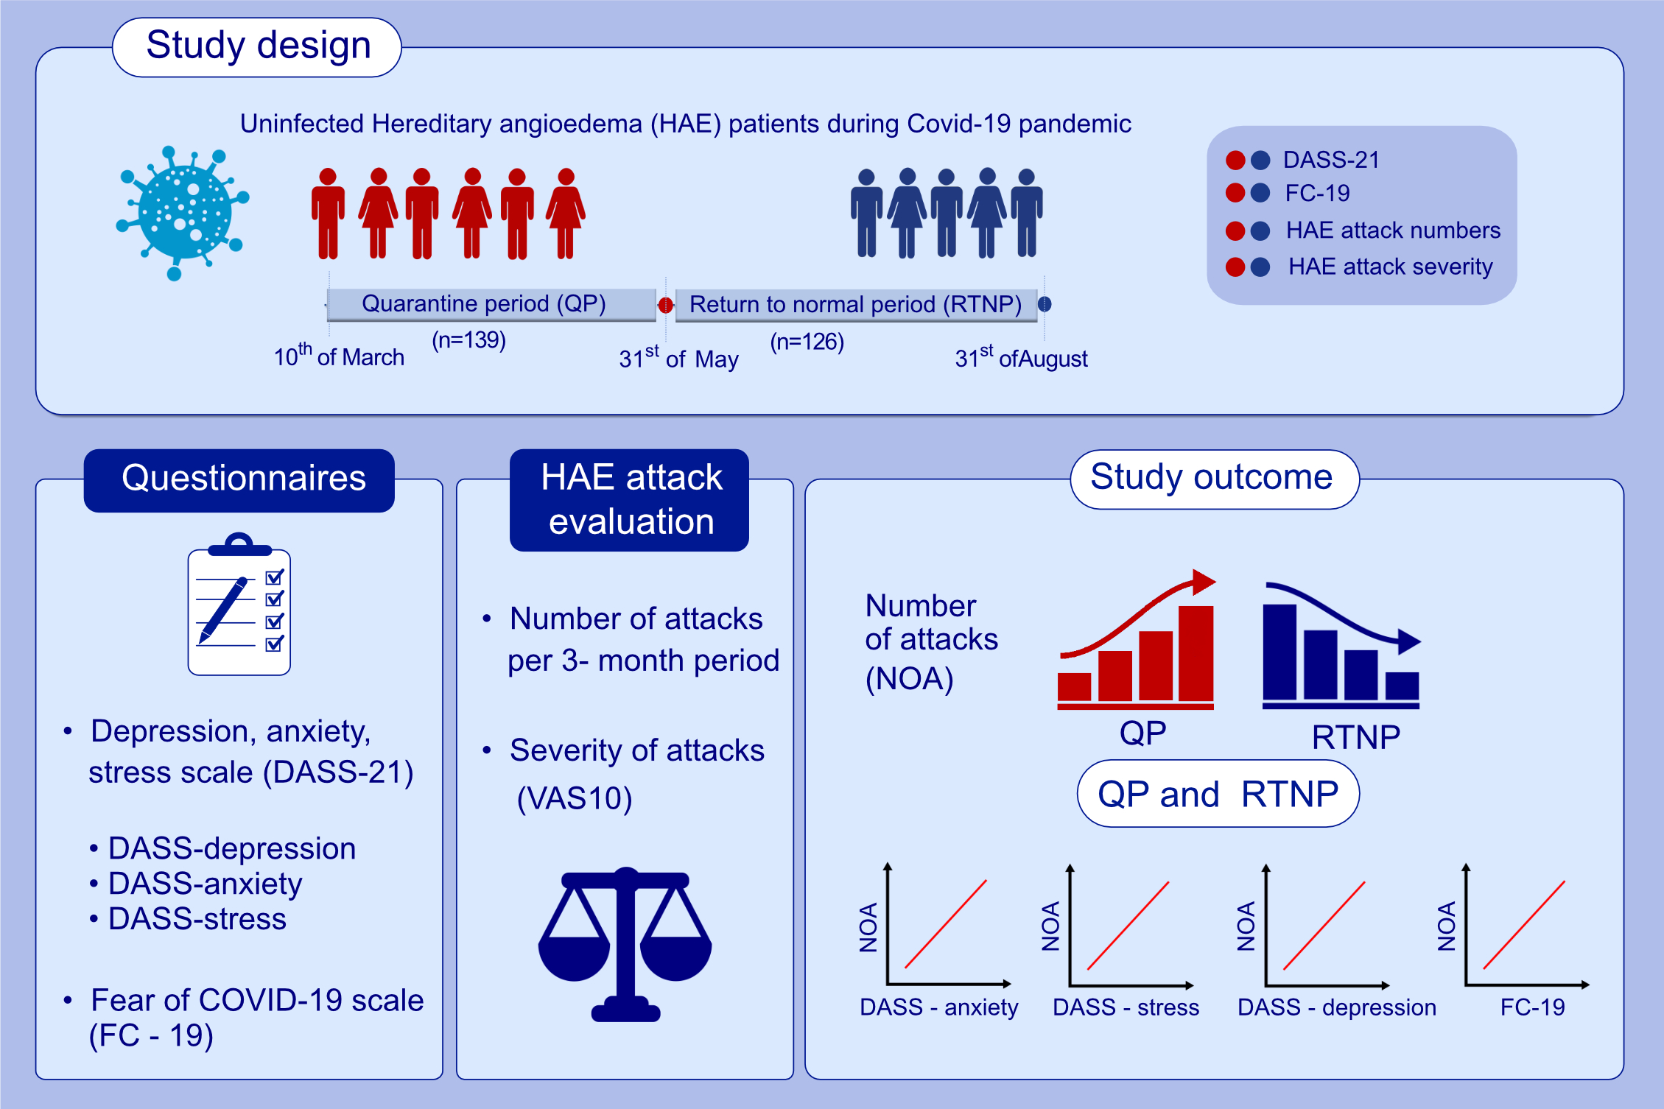
Impact of anxiety, stress and depression related to COVID-19 pandemic on the course of hereditary angioedema with C1-inhibitor deficiency
Deniz Eyice Karabacak,, Semra Demir,, Osman Ozan Yeğit,, Ali Can,, Kadriye Terzioğlu,, et al.
Allergy. 2021; 2535-2543 https://doi.org/10.1111/all.14796
© 2019 EAACI and John Wiley and Sons A/S. Published by John Wiley and Sons Ltd.
Notes:
HIGHLIGHTS
Uninfected HAE patients were assessed in QP and RTNP during COVID-19.
Number of HAE attacks, in correlation with DASS-stress, DASS-anxiety, DASS-depression and FC-19 scores, were higher in QP than RTNP, whereas attack severity was not different.
COVID-19 outbreak causes an increase in the number of HAE attacks in relation to anxiety, depression, stress and fear of Covid-19.
Abbreviations: DASS, depression anxiety stress scale; FC-19, fear of Covid-19 scale; HAE, hereditary angioedema; NOA, number of attacks; QP, quarantine period; RTNP, return to normal period; VAS10, visual analogue scale

