Slide 1
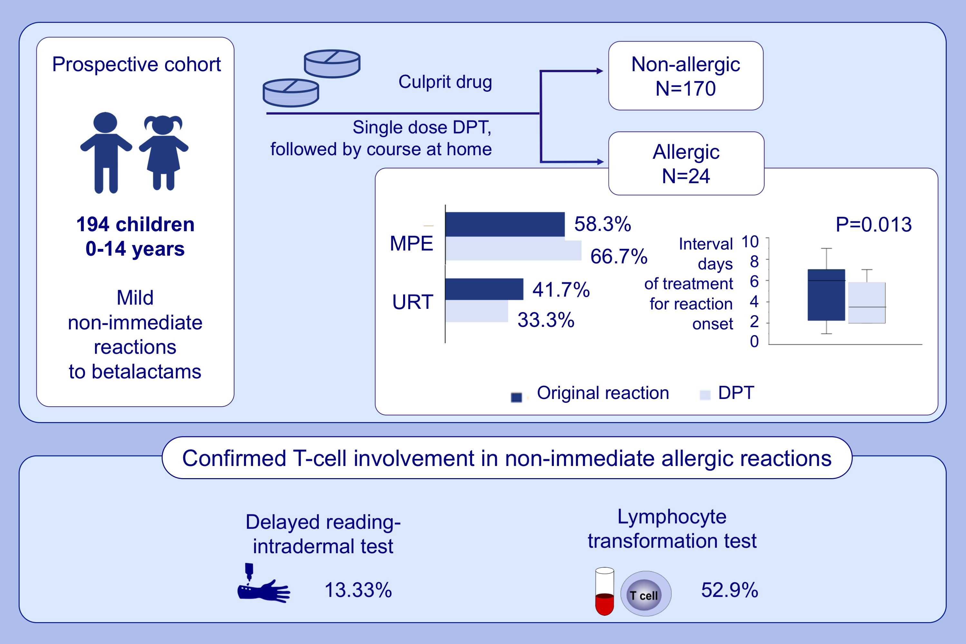
Single-dose prolonged drug provocation test, without previous skin testing, is safe for diagnosing children with mild non-immediate reactions to beta-lactams
Ana Prieto,, Candelaria Muñoz,, Gádor Bogas,, Rubén Fernández-Santamaría,, Francisca Palomares,, et al.
Allergy. 2021; 2544-2554 https://doi.org/10.1111/all.14800
© 2019 EAACI and John Wiley and Sons A/S. Published by John Wiley and Sons Ltd.
Notes:
HIGHLIGHTS
Allergy was confirmed in the 12.4% of children reporting non-immediate reactions to betalactams.
A shorter interval of days of treatment for reaction onset was found in DPT when comparing with the original reaction, but no differences were found regarding the percentage of experienced symptoms.
Delayed reading-intradermal and lymphocyte transformation tests were positive in 13.33% and 52.9% of allergic children, respectively.
Abbreviations: DPT, drug provocation test; MPE, maculopapular exanthema; URT, urticaria

