Slide 1
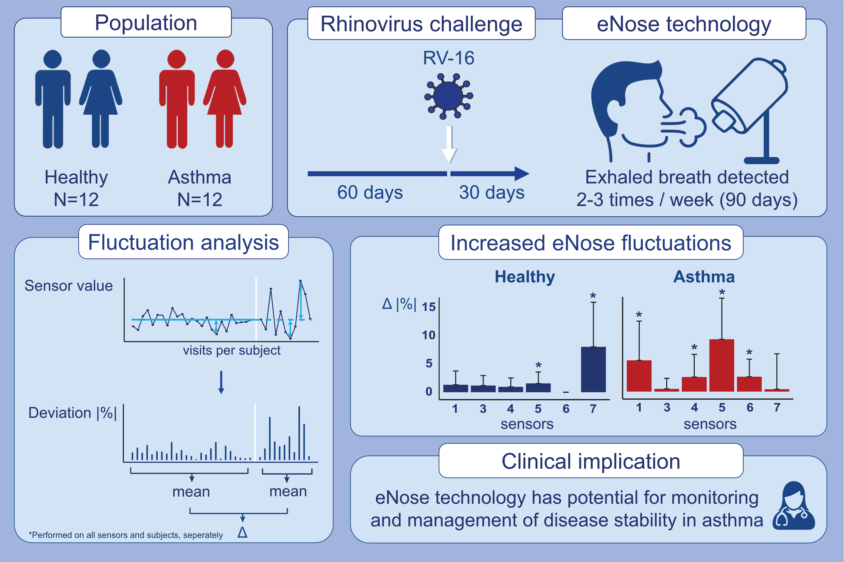
Increased day-to-day fluctuations in exhaled breath profiles after a rhinovirus challenge in asthma
Ariana Lammers,, Paul Brinkman,, Louwrina H. te Nijenhuis,, Rianne de Vries,, Yennece W. F. Dagelet,, et al.
Allergy. 2021; 2488-2499 https://doi.org/10.1111/all.14811
© 2019 EAACI and John Wiley and Sons A/S. Published by John Wiley and Sons Ltd.
Notes:
HIGHLIGHTS
eNose sensor fluctuations increased after a RV-16 challenge in asthmatic and healthy adults, more evidently in asthma.
In asthma, the increase in eNose fluctuations occurred before the onset of cold-like symptoms.
The magnitude of the change in eNose fluctuations was not correlated with FeNO and cold-like symptoms, but moderately correlated with pre- and post-challenge cytokine levels in asthma.
Abbreviations: FeNO, fractional exhaled nitric oxide; RV-16, rhinovirus-16

