Slide 1
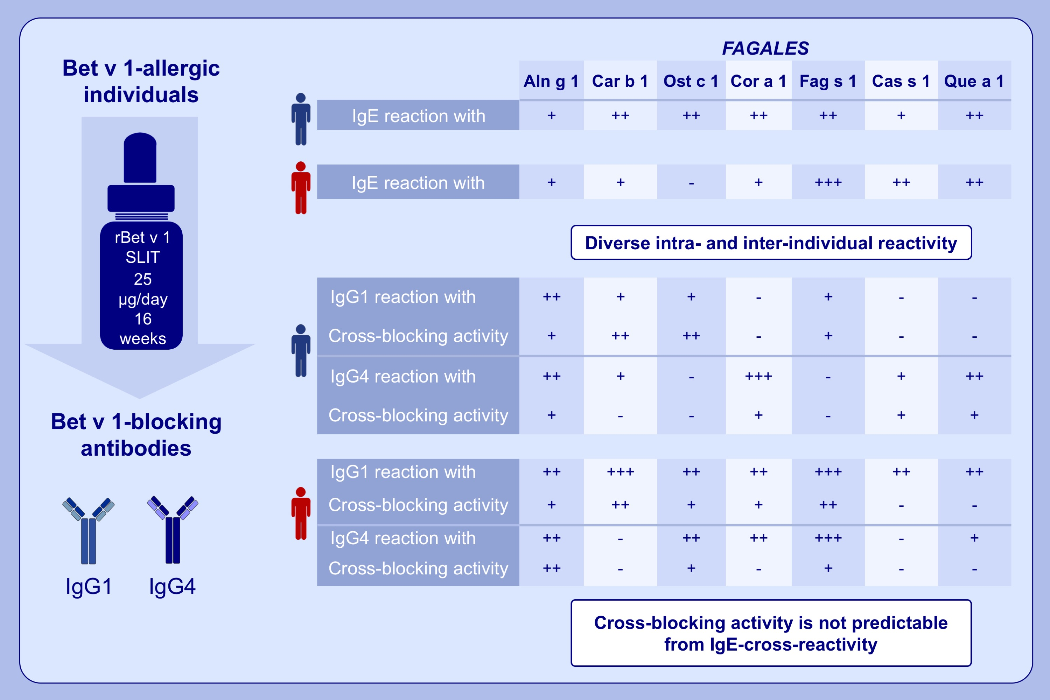
IgE-cross-blocking antibodies to Fagales following sublingual immunotherapy with recombinant Bet v 1
João Rodrigues Grilo,, Claudia Kitzmüller,, Lorenz Aglas,, Gabriela Sánchez Acosta,, Ute Vollmann,, et al.
Allergy. 2021; 2555-2564 https://doi.org/10.1111/all.14817
© 2019 EAACI and John Wiley and Sons A/S. Published by John Wiley and Sons Ltd.
Notes:
HIGHLIGHTS
IgE-cross-blocking antibodies to Fagales following sublingual immunotherapy with recombinant Bet v 1
Bet v 1-allergic individuals show IgE cross-reactivity with allergens from Fagales.
Sublingual immunotherapy with the reference allergen Bet v 1 induces individually diverse repertoires of cross-reactive IgG1 and IgG4 antibodies.
The cross-blocking bioactivity of IgG1 and IgG4 antibodies is highly variable and not predictable from IgE-cross-reactivity.

