Slide 1
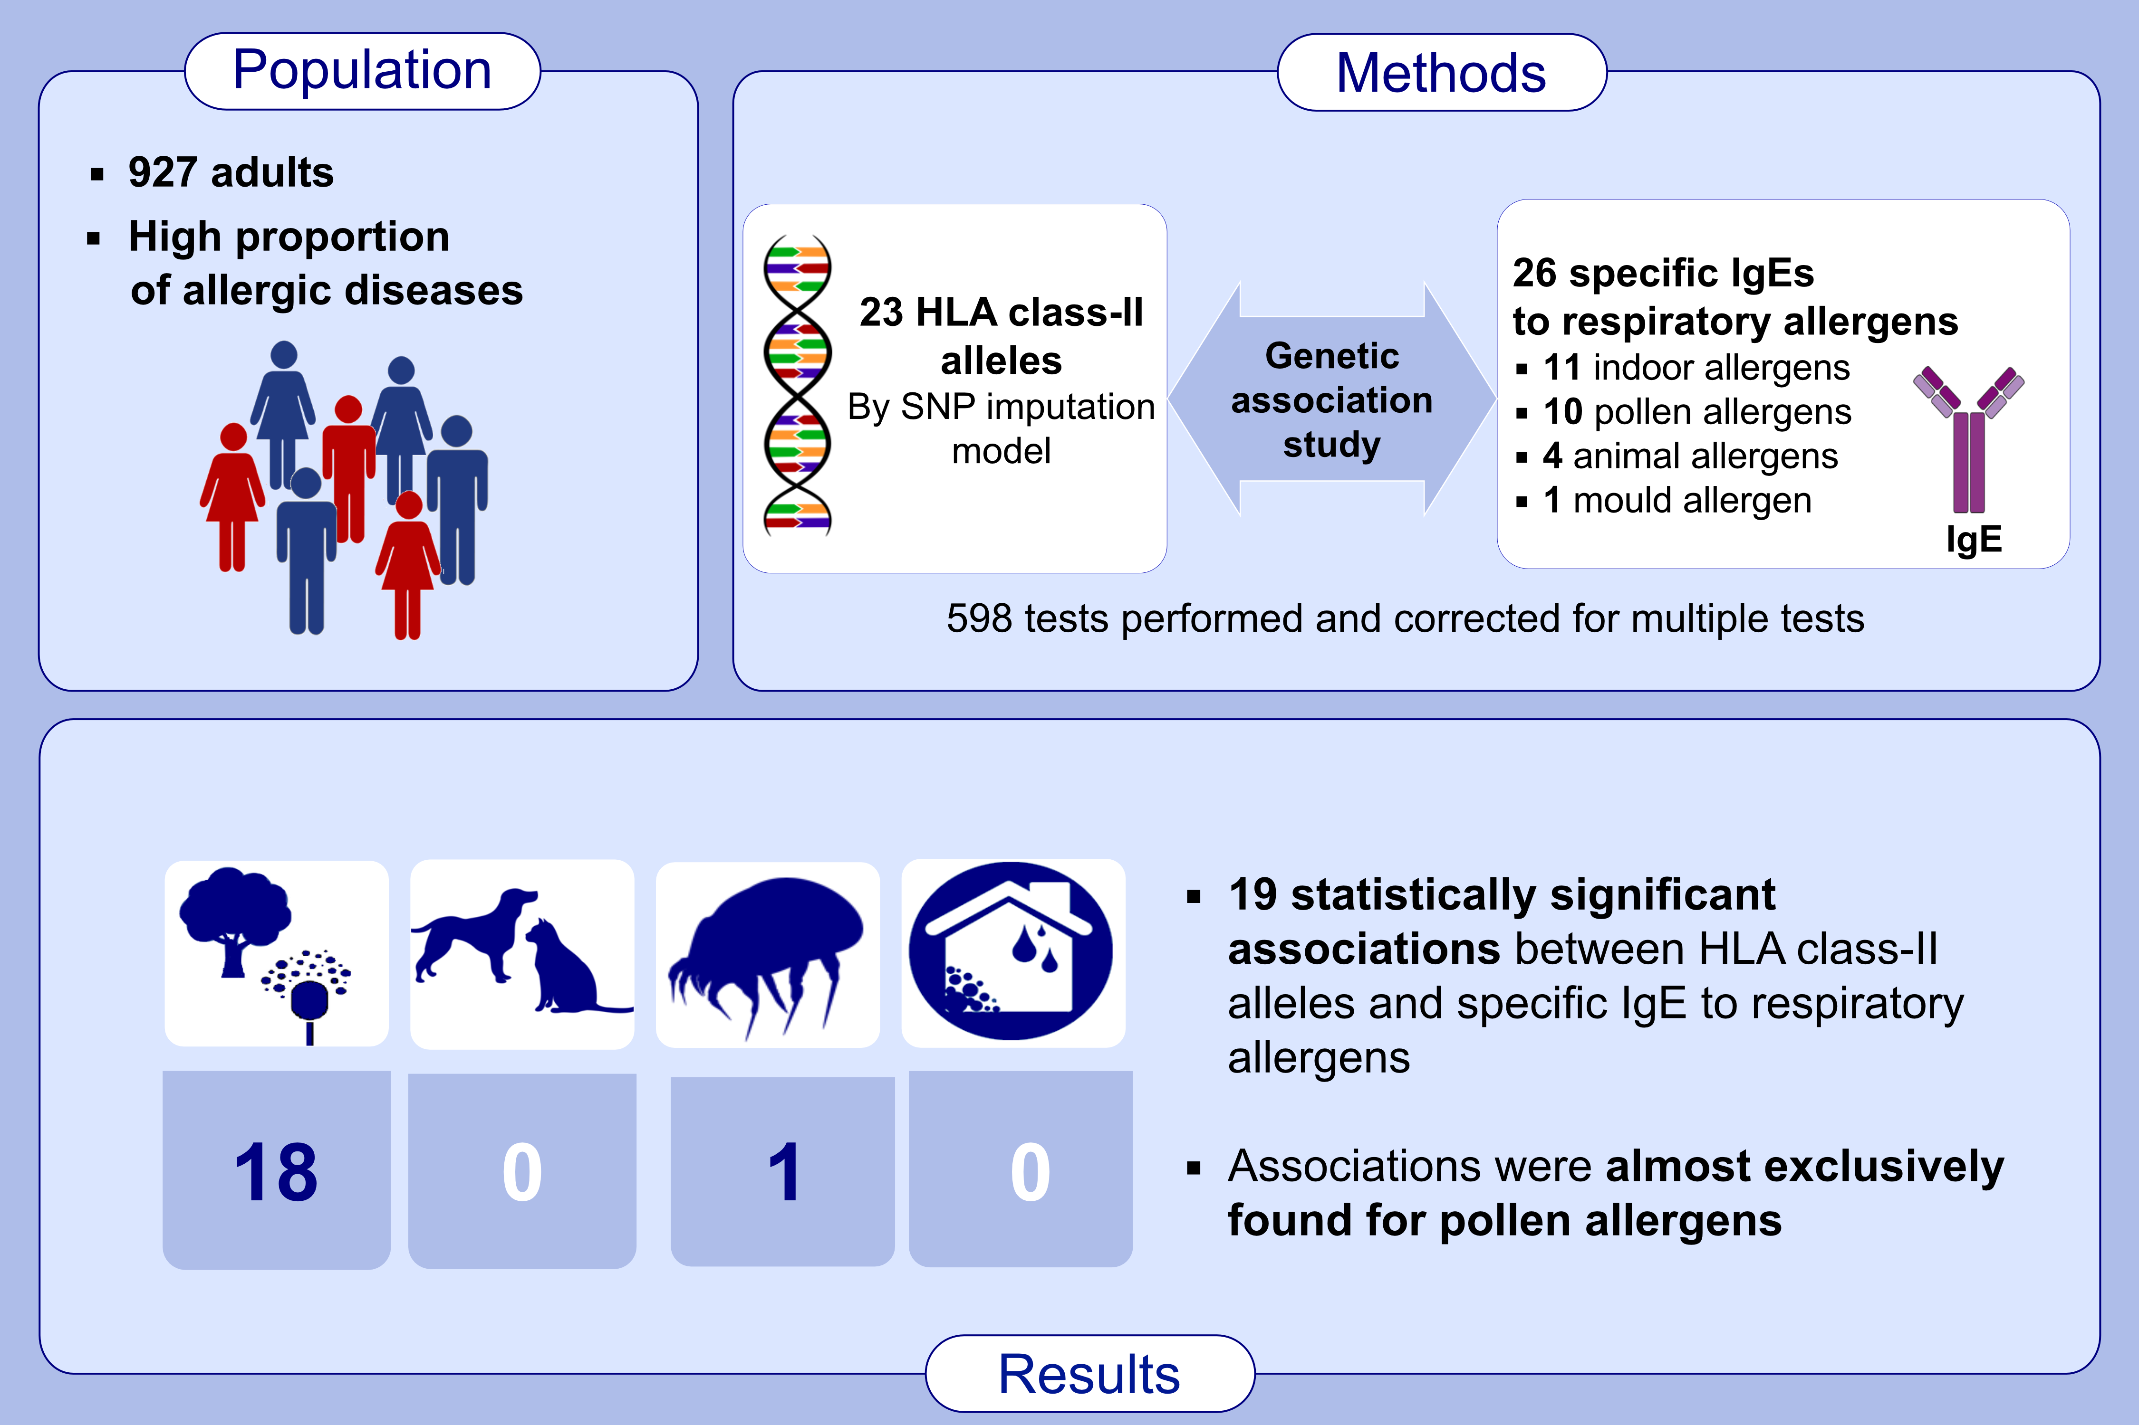
Associations between specific IgE sensitization to 26 respiratory allergen molecules and HLA class II alleles in the EGEA cohort
Hubert Gheerbrant,, Alicia Guillien,, Raphaël Vernet,, Christian Lupinek,, Christophe Pison,, et al.
Allergy. 2021; 2575-2586 https://doi.org/10.1111/all.14820
© 2019 EAACI and John Wiley and Sons A/S. Published by John Wiley and Sons Ltd.
Notes:
HIGHLIGHTS
This association study between HLA class-II alleles and specific IgE sensitization to a large panel of aeroallergens reveals 19 statistically significant associations, almost exclusively with pollen allergens.
The strongest associations are found for mugwort Art v1, with DQB1*05:01, DQA1*01:01 and DRB1*01:01 alleles.
HLA class-II alleles might be specifically associated with sensitization to seasonal allergens.
Abbreviations: IgE, immunoglobin E; HLA, human leukocyte antigen.
.

