Slide 1
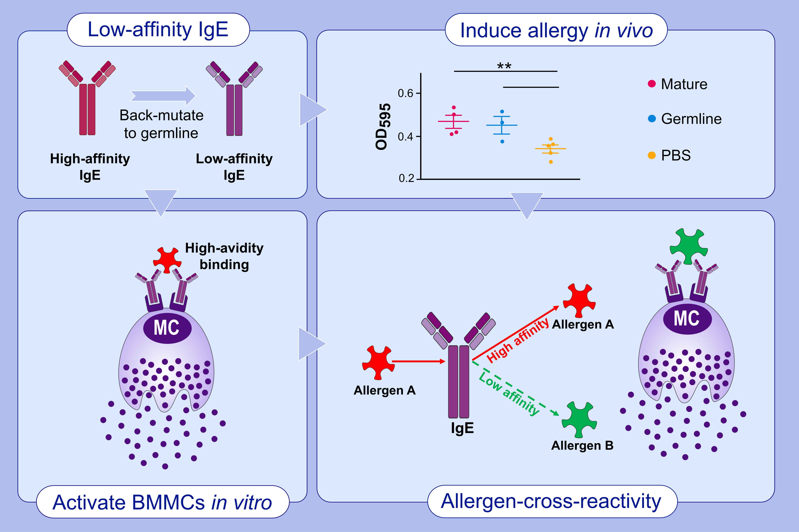
Low-affinity but high-avidity interactions may offer an explanation for IgE-mediated allergen cross-reactivity
Xinyue Chang,, Lisha Zha,, Alexandra Wallimann,, Mona O. Mohsen,, Pascal Krenger,, et al.
Allergy. 2021; 2565-2574 https://doi.org/10.1111/all.14864
© 2019 EAACI and John Wiley and Sons A/S. Published by John Wiley and Sons Ltd.
Notes:
HIGHLIGHTS
Germline IgE antibodies were of low-affinity to allergen.
Low affinity IgE antibodies are able to activate mast cells in vitro and in vivo via high avidity binding.
Allergen A induces specific high affinity IgE antibodies, but with low affinity to allergen B, which could activate mast cells by high-avidity binding to IgE antibodies.
Abbreviations: OD595, optical density 595 nm; PBS, phosphate-buffered saline

