Slide 1
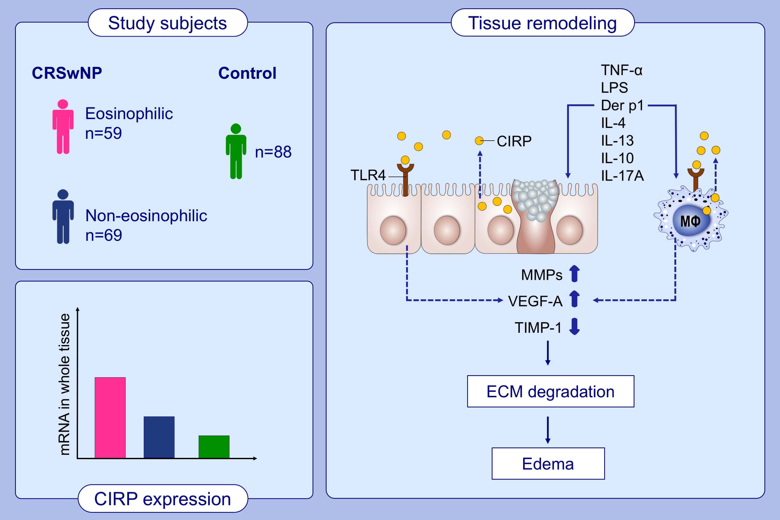
Cold‐inducible RNA‐binding protein contributes to tissue remodeling in chronic rhinosinusitis with nasal polyps
Li‐Li Shi, Jin Ma, Yi‐Ke Deng, Cai‐Ling Chen, Heng Wang, et al.
Allergy. Issue; 2021 https://doi.org/10.1111/all.14287
© 2019 EAACI and John Wiley and Sons A/S. Published by John Wiley and Sons Ltd.
Notes:
HIGHLIGHTS
Expression of CIRP in sinonasal tissues and nasal secretions is significantly increased in both patients with eosinophilic and non-eosinophilic CRSwNP.
TNF-α, LPS, Der p1, IL-4, IL-13, IL-17A and IL-10 induce the production and secretion of CIRP from nasal epithelial cells and macrophages.
The elevated CIRP then promotes MMP and VEGF-A production from macrophages and nasal epithelial cells via TLR4, and therefore contributes to the edema formation in both eosinophilic and non-eosinophilic nasal polyps.
Abbreviations: CIRP, cold-inducible RNA-binding protein; CRSwNP, chronic rhinosinusitis with nasal polyps; Der p1, Dermatophagoides pteronyssinus group 1; ECM, extracellular matrix; LPS, lipopolysaccharide; MMP, matrix metalloproteinase; TLR4, Toll-like receptor 4; TIMP, tissue metallopeptidase inhibitor; TNF-α, tumor necrosis factor-α; VEGF-A, vascular endothelial growth factor-A

