Slide 1
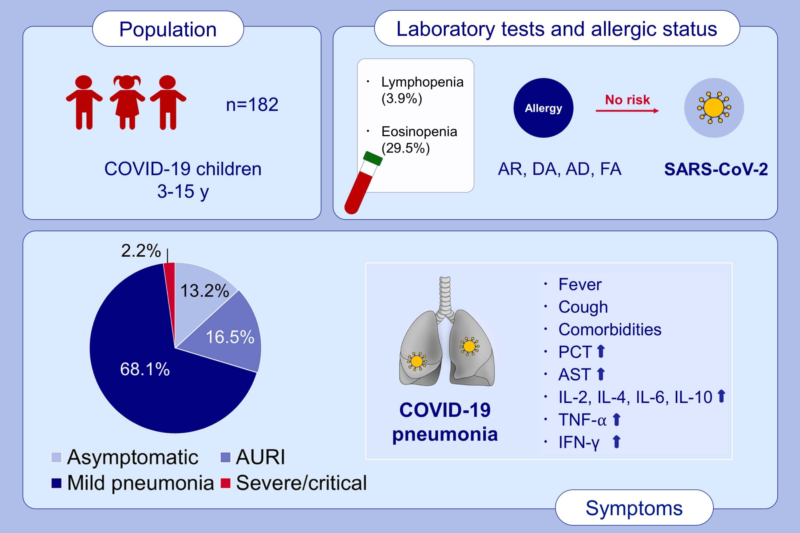
Clinical characteristics of 182 pediatric COVID‐19 patients with different severities and allergic status
Hui Du, Xiang Dong, Jin‐jin Zhang, Yi‐yuan Cao, Mubeccel Akdis, et al.
Allergy. Issue; 2021 https://doi.org/10.1111/all.14452
© 2019 EAACI and John Wiley and Sons A/S. Published by John Wiley and Sons Ltd.
Notes:
HIGHLIGHTS
There is no difference between allergic and non-allergic children in clinical features and laboratory/immunological findings, and allergy is not a risk factor for COVID-19.
The majority (97.8%) of infected children were not severe, and 24 (13.2%) of them had asymptomatic infections. Laboratory results were mostly within normal ranges, and only a small ratio of lymphopenia (3.9%) and eosinopenia (29.5%) were observed.
Higher proportion of patients with pneumonia have fever, cough, comorbidities, and increased inflammatory biomarkers (procalcitonin, alkaline phosphatase and serum interleukins (IL)-2, IL-4, IL-6, IL-10 and TNF-α) than those without pneumonia.
Abbreviations: AD, atopic dermatitis; AR, allergic rhinitis; AST, aspartate aminotransferase, AURI, acute upper respiratory infection; COVID-19, coronavirus disease 2019; DA, drug allergy; FA, food allergy; PCT, procalcitonin; SARS-CoV-2, severe acute respiratory syndrome coronavirus 2; TNF, tumor necrosis factor

