Slide 1
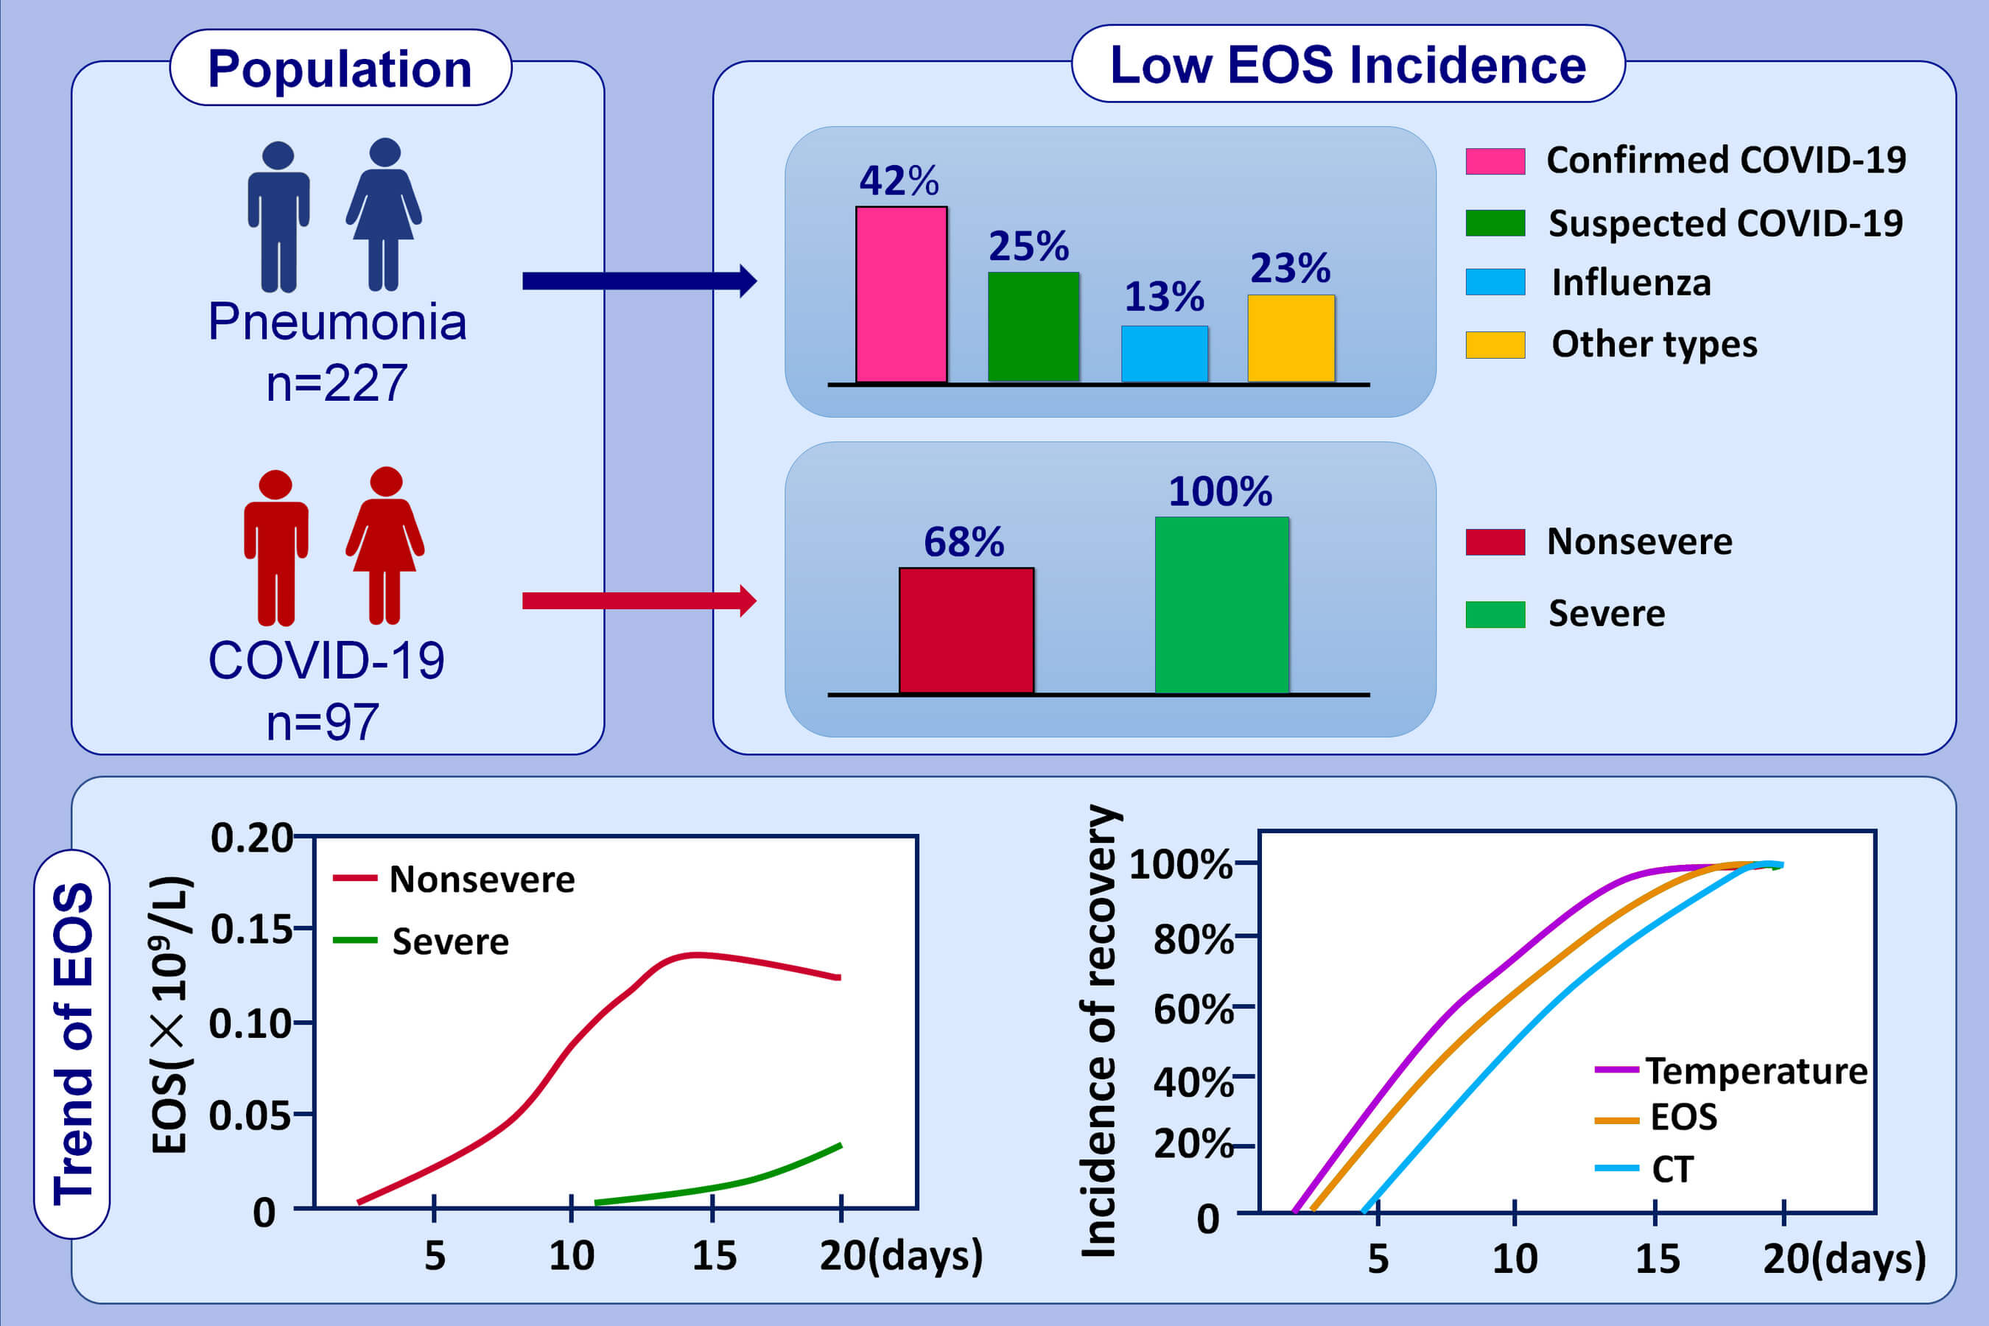
The role of peripheral blood eosinophil counts in COVID‐19 patients
Guogang Xie, Fengming Ding, Lei Han, Dongning Yin, Hongzhou Lu, et al.
Allergy. Issue; 2021 https://doi.org/10.1111/all.14465
© 2019 EAACI and John Wiley and Sons A/S. Published by John Wiley and Sons Ltd.
Notes:
HIGHLIGHTS
The circulating eosinophil counts decrease dramatically in most COVID-19 patients.
Low eosinophil counts and slow recovery may be related to severe conditions.
The restore of eosinophil counts is synchronous with the improvement of chest CT, later than that of body temperature, but earlier than the negative conversion of nucleic acid assays.
Abbreviations: COVID-19, coronavirus disease 2019; CT, computed tomography; EOS, eosinophil

