Slide 1
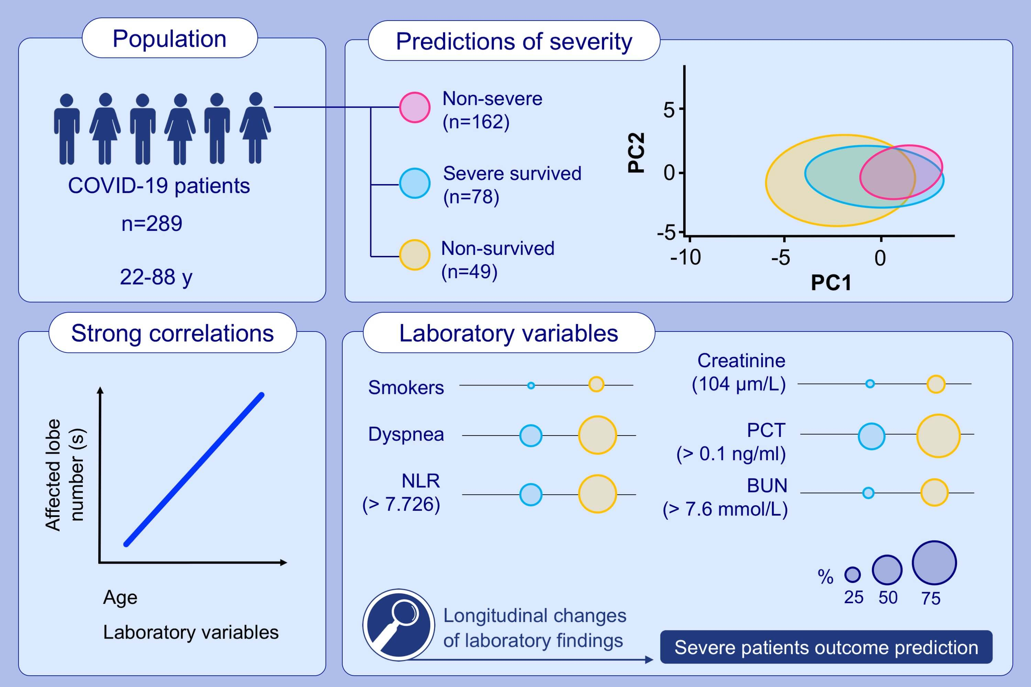
Clinical, radiological, and laboratory characteristics and risk factors for severity and mortality of 289 hospitalized COVID‐19 patients
Jin‐jin Zhang, Yi‐yuan Cao, Ge Tan, Xiang Dong, Bin‐chen Wang, et al.
Allergy. Issue; 2021 https://doi.org/10.1111/all.14496
© 2019 EAACI and John Wiley and Sons A/S. Published by John Wiley and Sons Ltd.
Notes:
HIGHLIGHTS
This study compares the clinical, radiological and laboratory characteristics and longitudinal variations in laboratory parameters of the 289 hospitalized patients with COVID-19 with different severity and clinical outcomes.
We propose that elder age, a greater number of affected lobe(s), elevated C- CRP level and increased prevalence of chest tightness/dyspnea and smoking history may be associated with the fatal outcome of patients with severe COVID-19.
We identify strong correlations between age, affected lobe numbers and laboratory variables.
Abbreviations: BUN, blood urea nitrogen; COVID-19, coronavirus infectious disease 2019; CRP, C-reactive protein; NLR, neutrophil-to-leucocyte ratio; PC1/2, principal component 1/2; PCT, procalcitonin

