Slide 1
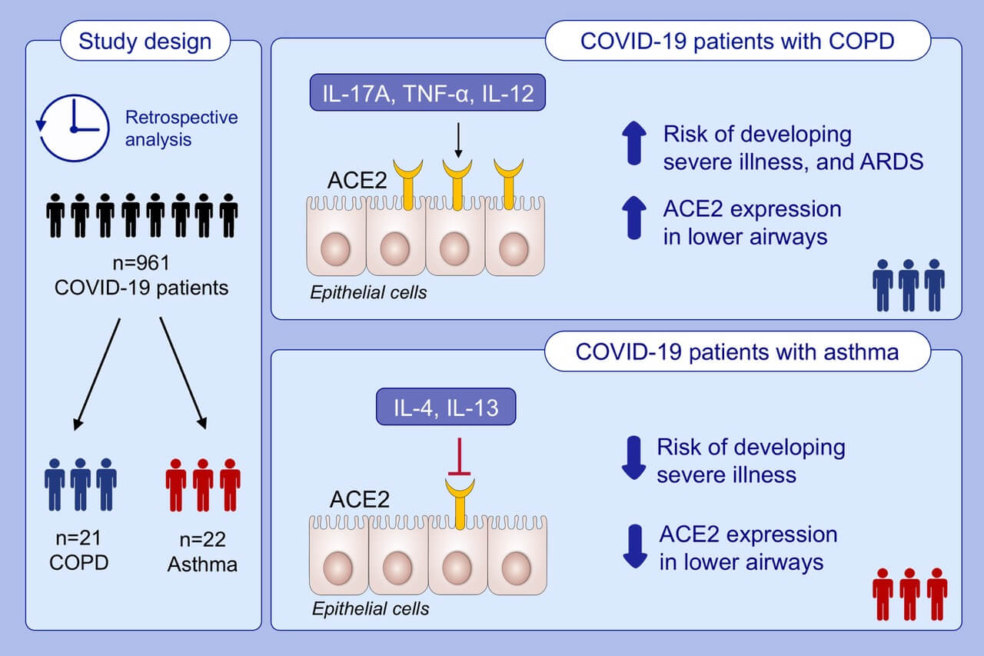
Distinct effects of asthma and COPD comorbidity on disease expression and outcome in patients with COVID‐19
Jia Song, Ming Zeng, Hai Wang, Chuan Qin, Hong‐Yan Hou, et al.
Allergy. Issue; 2021 https://doi.org/10.1111/all.14517
© 2019 EAACI and John Wiley and Sons A/S. Published by John Wiley and Sons Ltd.
Notes:
HIGHLIGHTS
After adjusting for confounding factors, COVID-19 patients with COPD have higher risks of developing severe illness and acute respiratory distress syndrome than COVID-19 patients with asthma.
COPD patients have increased, whereas asthmatics have decreased ACE2 protein expression in lower airways, compared with that in control subjects without asthma and COPD.
IL-17A, TNF-α, and IL-12 promote, while IL-4 and IL-13 suppress ACE2 expression in airway BEAS-2B cells.
Abbreviations: ACE2, angiotensin-converting enzyme II; ARDS, acute respiratory distress syndrome; BEAS-2B, adenovirus-12 SV40 hybrid virus transformed bronchial epithelial cells; COPD, chronic obstructive pulmonary disease; COVID-19, coronavirus disease 2019

