Slide 1
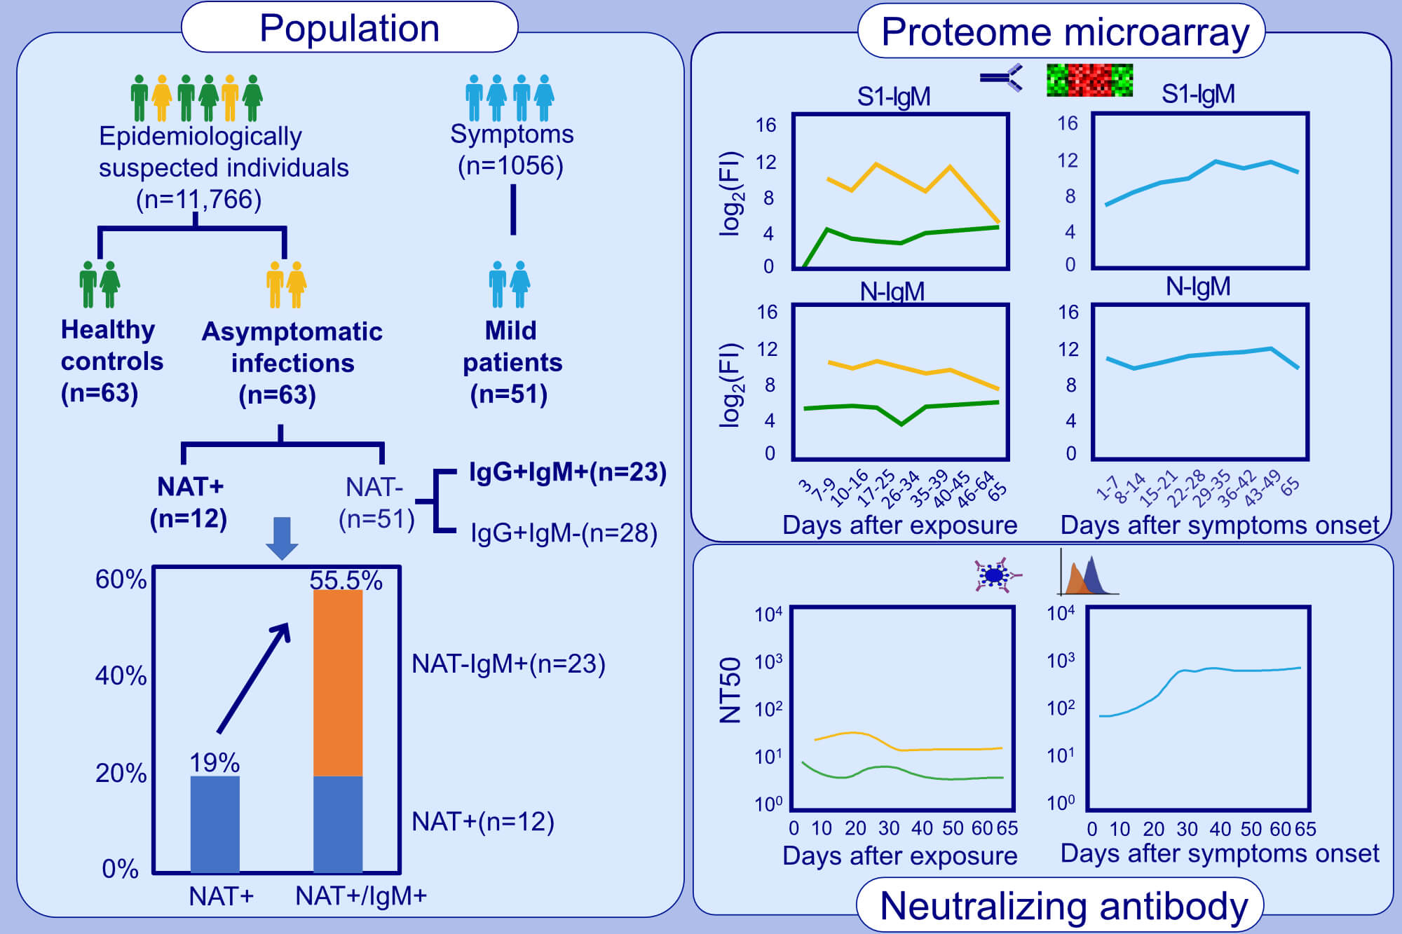
Antibody dynamics to SARS-CoV-2 in asymptomatic COVID-19 infections
Qing Lei, Yang Li , Hong‐yan Hou, Feng Wang, et al.
Allergy. Issue; 2021 https://doi.org/10.1111/all.14622
© 2019 EAACI and John Wiley and Sons A/S. Published by John Wiley and Sons Ltd.
Notes:
HIGHLIGHTS
The combination of NAT and serological testing for IgM antibody significantly improves the detection sensitivity of asymptomatic COVID-19 infections, compared with NAT alone.
S1 specific IgM antibody response with rapid emergence and disappearance might be helpful to assist NAT for early identification of infectious individuals.
A majority of asymptomatics induce very low levels of neutralizing antibody that disappear in two months.
Abbreviations: NAT, nucleic acid testing; FI, fluorescence intensity; NT50, half-maximal neutralizing titer

