Slide 1
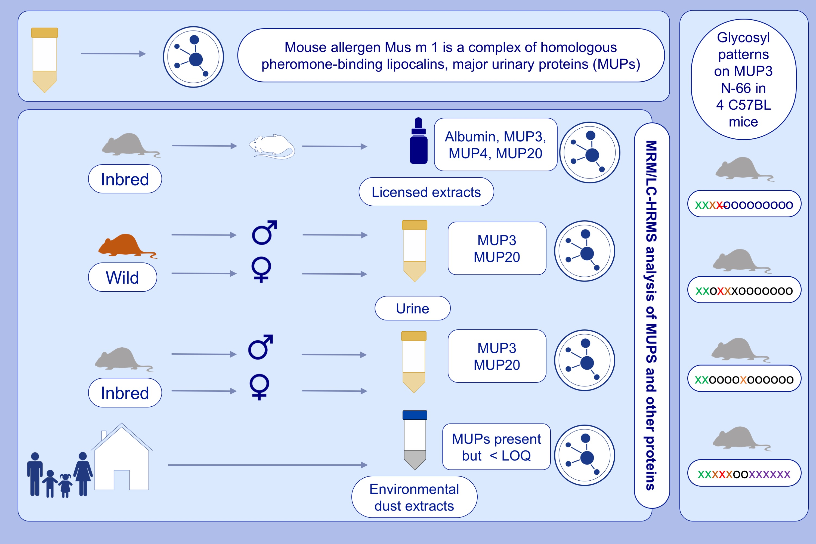
Diversity and complexity of mouse allergens in urine, house dust, and allergen extracts assessed with an immuno-allergomic approach
Samuel T. Mindaye,, Carl Sun,, Sayyed Amin Zarkesh Esfahani,, Elizabeth C. Matsui,, Michael J. Sheehan,, et al.
Allergy. 2021; 3723-3732 https://doi.org/10.1111/all.14860
© 2019 EAACI and John Wiley and Sons A/S. Published by John Wiley and Sons Ltd.
Notes:
HIGHLIGHTS
Commercial mouse epithelial extracts are heterogeneous, and their allergen profiles differ from mouse urine. The former contain predominantly albumin,
the latter MUPs.
MUPs are present in environmental dust.
MUPs are expressed differentially in individual mice, in males and females,
and in wild mice versus inbred mice. Glycosylation of MUPs adds a further level
of individualized complexity.
Abbreviations: HRMS, high resolution mass spectrometry; LC, liquid chromatography; MRM, multiple reactions monitoring; MUP, major urinary proteins

