Slide 1
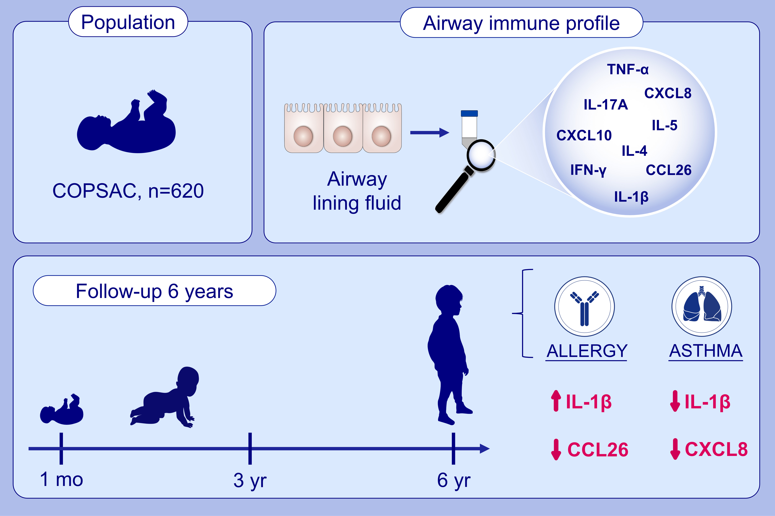
Neonatal airway immune profiles and asthma and allergy endpoints in childhood
Bo L. Chawes,, Helene M. Wolsk,, Christian J. Carlsson,, Morten A. Rasmussen,, Nilofar Følsgaard,, et al.
Allergy. 2021; 3713-3722 https://doi.org/10.1111/all.14862
© 2019 EAACI and John Wiley and Sons A/S. Published by John Wiley and Sons Ltd.
Notes:
HIGHLIGHTS
This study examines whether the airway cytokine/chemokine profile is associated with development of asthma and allergy later in childhood.
20 immune mediators were measured in the airway mucosal lining fluid of 620 one-month old healthy neonates.
Distinct airway immune profiles are associated with development of inhalant allergy (higher IL-1β and lower CCL26) and asthma (lower IL-1β and CXCL8), suggesting an early origin and different pathogenesis of childhood asthma and allergy.
Abbreviations: COPSAC, Copenhagen Prospective Studies on Asthma in Childhood;
CCL, C-C motif chemokine ligand; CXCL, C-X-C motif chemokine ligand; IL, interleukin; INF, interferon; TNF, tumor necrosis factor

