Slide 1
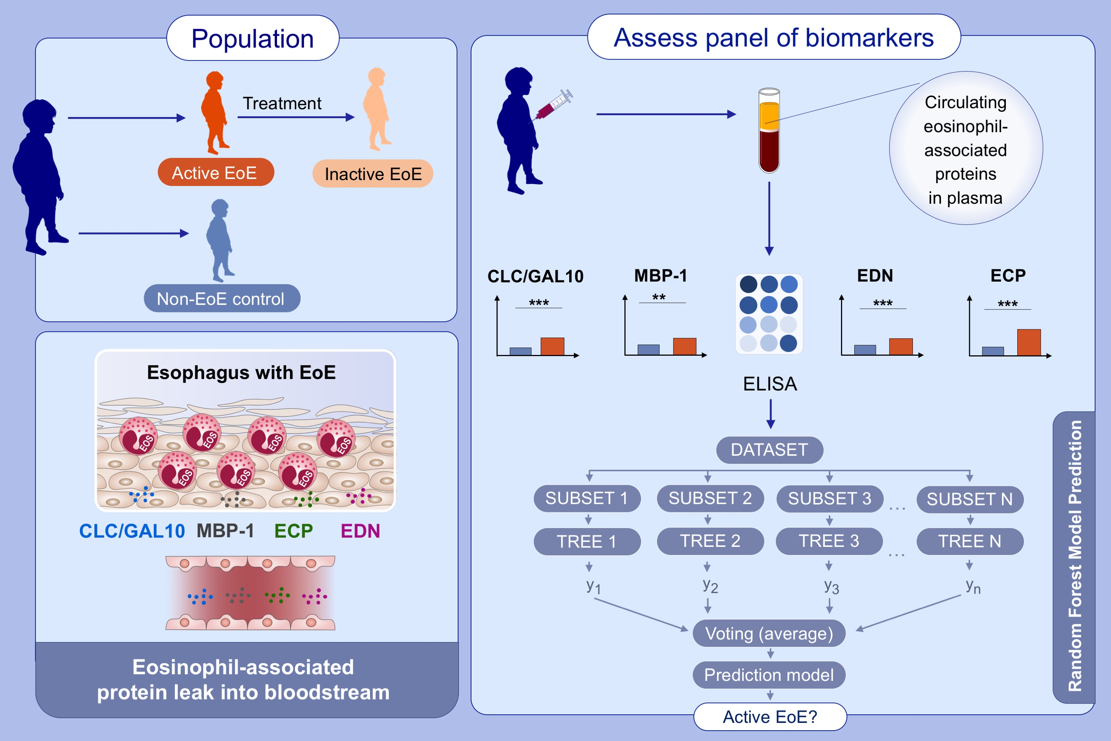
Noninvasive biomarkers identify eosinophilic esophagitis: A prospective longitudinal study in children
Joshua B. Wechsler,, Steven J. Ackerman,, Mirna Chehade,, Katie Amsden,, Mary E. Riffle,, et al.
Allergy. 2021; 3755-3765 https://doi.org/10.1111/all.14874
© 2019 EAACI and John Wiley and Sons A/S. Published by John Wiley and Sons Ltd.
Notes:
HIGHLIGHTS
A panel of eosinophil-associated plasma proteins along with AEC are superior to AEC alone in distinguishing EoE from non-EoE.
A panel of AEC and MBP-1 predicted esophageal eosinophil counts superior to AEC alone longitudinally.
Histologic responders to EoE treatment have a greater reduction in AEC, CLC/GAL-10, ECP, and MBP-1 than non-responders.
Abbreviations: EoE, eosinophilic esophagitis; AEC, absolute eosinophil count; CLC/GAL10, galectin-10; ECP, eosinophil cationic protein; EDN, eosinophil-derived neurotoxin; MBP-1, major basic protein

