Slide 1
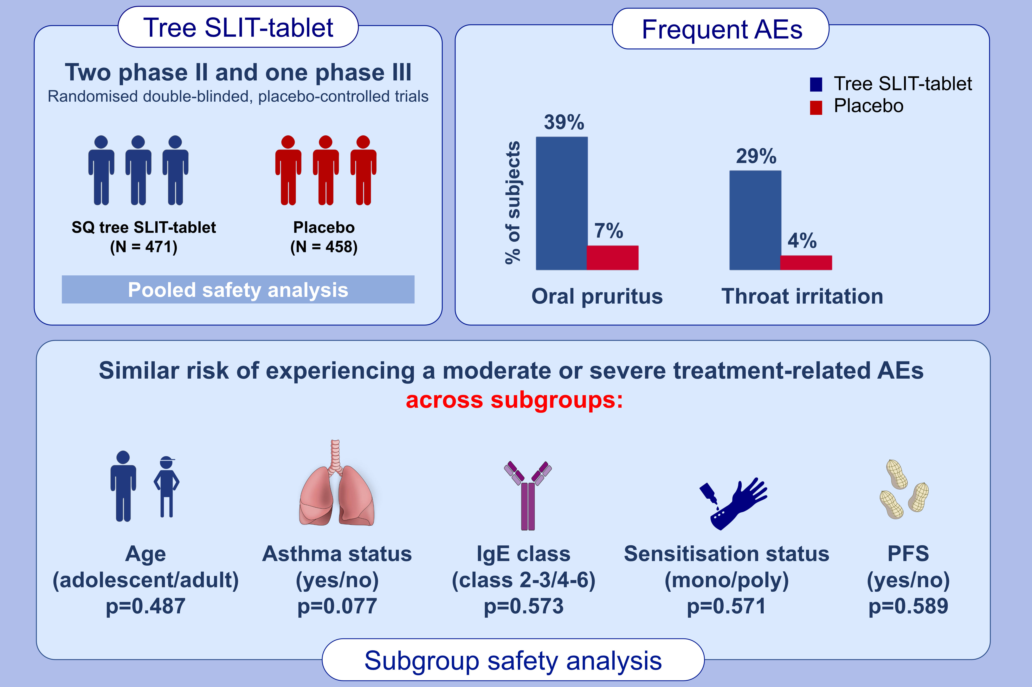
Safety of the standardized quality tree sublingual immunotherapy tablet: Pooled safety analysis of clinical trials
Tilo Biedermann,, Peter Couroux,, Tina Maria Greve,, Mika Mäkelä
Allergy. 2021; 3733-3742 https://doi.org/10.1111/all.14882
© 2019 EAACI and John Wiley and Sons A/S. Published by John Wiley and Sons Ltd.
Notes:
HIGHLIGHTS
Tolerability and safety of the SQ tree SLIT-tablet was investigated using pooled safety data from two phase-II and one phase-III trials in adults and adolescents with allergic rhinitis and/or conjunctivitis.
Most frequent treatment-related adverse events with the tree SLIT-tablet were oral pruritus and throat irritation.
No differences were seen in the risk of moderate to severe adverse events across subgroups.
Abbreviations: AEs, adverse

